Slide 1
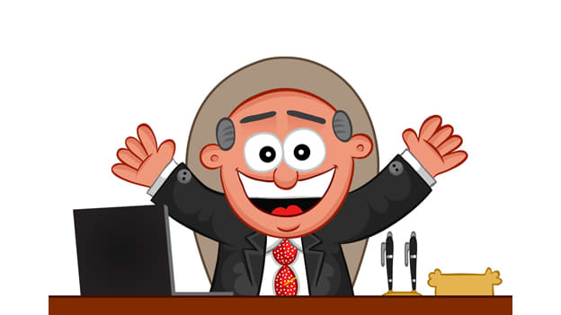

Performance Management
The ongoing process In which managers and employees regularly communicate to assess and review job responsibilities, expectations, performance and development strategies.
This Photo by Unknown Author is licensed under CC BY-SA-NC

Slide 2
What Is it really?
Empowering employees to perform at their best, align their efforts with company strategy and objectives and create a positive and fulfilling work environment
Everyone wants to enhance the employee experience – retention is key
Performance management is:
Part of the experience
Much more than the annual performance review
It’s what you measure along with how you measure
It’s about every employee’s accountability to meet the goals of the company
It’s about the day-in and day-out operational responsibilities that keep a company going in the right direction
It’s about the health and welfare and safety of the company and it’s employees
It’s about setting performance standards/goals and tracking progress (very rarely is this a straight line)
It’s about giving feedback (the good and the tough) on a regular basis…oh – is that called communication?

Slide 3
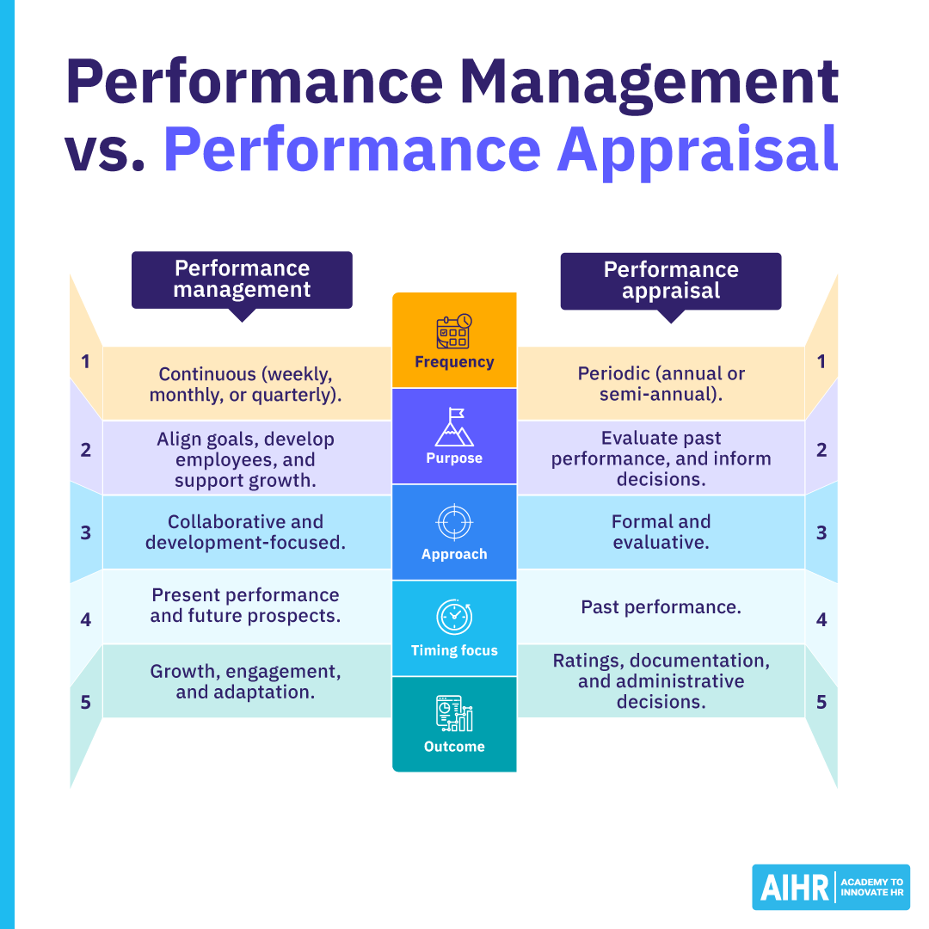

Slide 4
Key considerations
Performance goals should reflect values and strategic vision of your company
Managed performance should tie to the employee’s job description, which in turn aligns with values, vision and goals (strategy)
Feedback is essential to grow and develop your staff
Without feedback, it is left to the imagination of your team (that can be truly enlightening or disastrous)
Ask yourself – don’t you want to know?
It’s up to you to decide how best to provide
Performance standards are expectations described as:
Behaviors – what you want the employee to do
Results – what you want the employee to produce or deliver
SMART: Specific – Measurable – Achievable – Relevant – Time Bound
High-performance workplaces have:
Top management support
Positive environment
Seek feedback from managers, peers, customers
Provide proper resources and tools
Consistent management practices

Slide 5
Are we failing? Or…. are we hitting it out of the park?
Do you examine what is working and what isn’t
Determine where we are falling short
Does anyone “love’ the process or the end result
Is HR happy because there is documentation
Does the process leave our managers and our team feeling engaged or motivated
Is it time to do a performance review on our performance review process?

Slide 6
What are our options?
Give them up entirely
Use a different method
Are we measuring learning inputs or learning velocity
How many inputs were completed (courses or certifications or hours logged)
Or, with velocity we can measure skills gained, behavior changed, capability built/grown
Is the employee fully productive
Provide more guidance and structure for those who conduct evaluations
Provide less structure – let the review fit the role and the individual
One size does not fit all
If it’s working – but not the greatest
Will you move this up the ladder and make it a priority

Slide 7
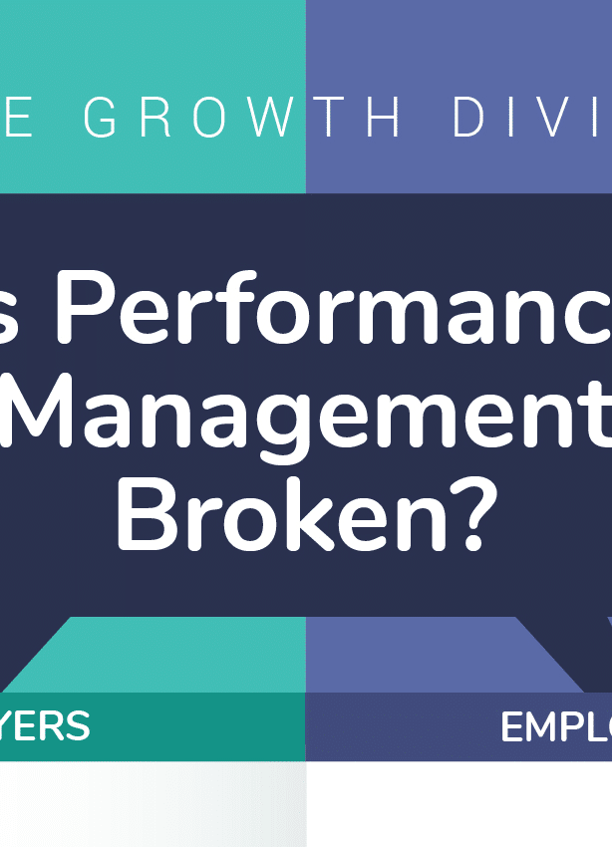
Assumption: most of us won’t give up on the process
Move this to the top 1-2 priorities for your organization
Failure to do so will impact your culture, retention, output, service and your bottom line
Have you noticed how culture impacts the process and the process impacts the culture?
This Photo by Unknown Author is licensed under CC BY-NC-ND

Slide 8
HEllo LEADERs- Your fundamental responsibilities:
Know your company handbook, policies and procedures
Know about your company/department – strategic plans, budget, operations and history
Lead by example – practice fair and consistent implementations
Make sure your employees understand your expectations– do you have job descriptions?
Communicate frequently, clearly, concisely
Set standards for yourself and live by them
If you say you are going to meet quarterly, do it
Spend the appropriate amount of time to accurately provide performance oversight
Be proactive in providing timely training and education (whether it be procedural or other training such as workplace conduct)

Slide 9
Impact - do we know what impacts our business and our employees? how much control do we have?
Culture
Structure
Industry type
Political and social changes
Retention
Worker availability
Remote or hybrid working structure
Level of training and development
Internal mobility
Where your organization is in the life cycle of the business
Financial demand (compensation as it relates to housing and living costs)

Slide 10
Every day performance management
Don’t wait until the quarterly or (worse yet) the annual review to have performance conversations with your team
Recognize them and thank them frequently when they do something right or above and beyond
Same goes when they need redirection – talk about it right away, while everything is still fresh
Especially critical if there is a safety issue
Depending on the situation, communications can be simple and conversational – a reminder
Follow up is essential – especially in substandard performance settings

Slide 11
Job Description Example
Add your logo and company information.
Be sure to have employee read and sign.
Keep in employee personnel file.
You can use any format that works within your company or industry.

Slide 12
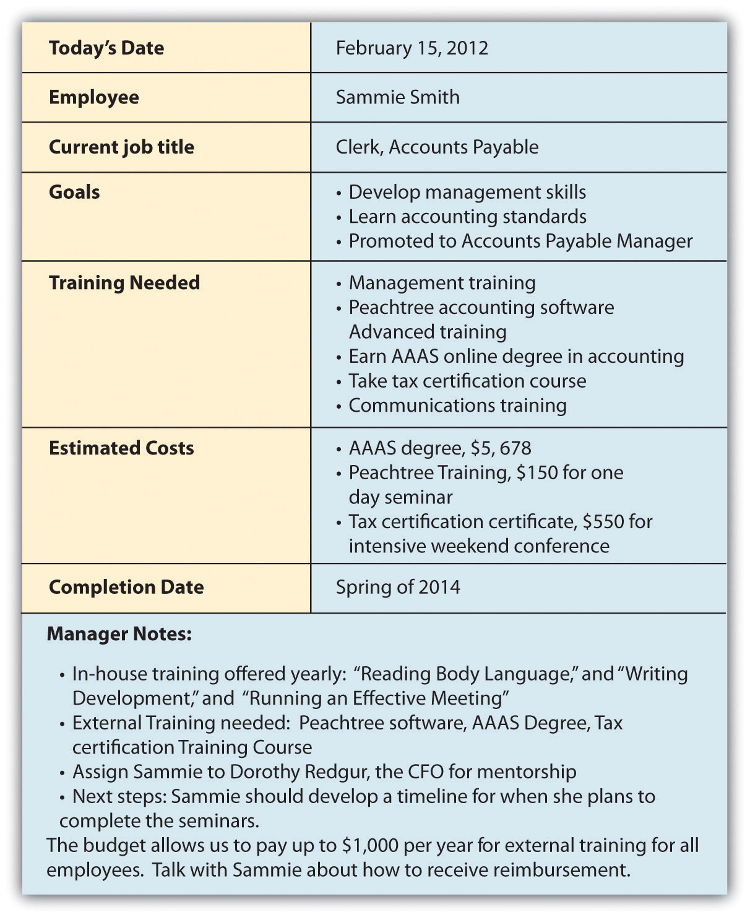
Individual Development Plan - IDP
Aligned with company goals and strategies
For all employees or leaders only?
Helps to set goals and track achievement (velocity)
Increase employee engagement
Increased productivity
Cream rises to the top
People Strategy Process
This Photo by Unknown Author is licensed under CC BY-SA-NC

Slide 13
Performance evaluation process different methods
Category Ranking Method
Graphic scale – typically a 1 – 5 rating
Checklist – From a list of words or statements, appraiser checks items that best fit characteristics and performance of employee
Comparative Ranking – ranks employees in order of best to poorest performance
360 Degree Review
Involves feedback of manager, supervisor, team members and direct reports
Collect a complete profile – evaluation of work performance, technical skill set and feedback about the employee
Caution – how this information is summarized and shared is critical

Slide 14
BARS performance method Behaviorally anchored rating scale
 |  | (Based on key components in the job description)
Outstanding | 5 | Positive and cheerful with visitors in-person and on telephone; good communication; organized; efficient; takes initiative; works independently and accurately
 | 4 | Cheerful and organized; completes projects accurately as directed
Satisfactory | 3 | Pleasant with visitors; organized; needs some direction on projects and new situations
 | 2 | Proficient with phone but makes some call transfer errors; usually organized; needs direction on most projects
Unsatisfactory | 1 | Uncomfortable with phone except for basics; call transfer errors frequent; desk gets cluttered frequently; forgets about customers when working on a project

Slide 15
Common Errors
Similar-to-me effect: judge someone more favorably if their background and beliefs are similar to your own
Central effect: rate employee in the middle – does not account for above average or below average
Bias: appraiser’s personal values, beliefs or prejudices distort ratings (intended or not)
Failure to complete: gets behind so doesn’t complete at all – then one period goes by and then another…..
Contrast error: evaluate employee relative to other employees rather than on job criteria
First impression error: make initial judgment, either favorable or unfavorable, which distorts future judgment on performance
Recency effect: give extra weight on recent performance – could be negative or positive and doesn’t fairly consider the whole period of performance
Halo effect: Employee is extremely competent in one area so ratings are high in all areas
Horn effect: opposite of halo effect – focuses on area on weakness resulting in overall low rating

Slide 16

PROXIMITY BIAS Tendency of managers to favor employees who work physically closer to them
Especially became noticeable with COVID and workers went to a remote status
Hybrid workers
Branch or different physical offices
Could be the same physical work location but appearances at after hours events are more pronounced
Same physical work location but on different floors
Different time zones

Slide 17
Narrative vs. numerical or a combination?
Narrative - Pros and cons
Numerical - pros and cons
A number without context is lacking - adds depth to the numerical rating
Easier to identify special events or recognition
Provides good examples
Can be obvious in bias
Can be incomplete or lacking in clarity
SHRM study 2026 w/1600 participants voted narrative as the favorite
Number can be misinterpreted: is a 3 out of 5 good or just okay
Using a wider scale such as 1 – 10 is more difficult to pinpoint performance – what is the difference between a 5 and a 6
___________
Fast to complete and are quantifiable
When managing large #’s of EE – can be efficient
Especially favored by employees when #’s are strong/higher and are specifically tied to compensation

Slide 18
performance management conversations helpful hints
Use specific examples whether identifying good performance or if redirecting
Use quantifiable (numerical) data where appropriate
Be sure you are measuring actual duties, competencies, key results areas
Don’t try to complete the official review in one sitting – give yourself time to do it right
Honor your employee and yourself by providing the right environment to conduct any performance management conversation (whether it is the daily oversight or the annual)
Be solution-based (action plan oriented) if redirecting

Slide 19
performance management conversations helpful hints
Focus on positive delivery and results
When giving feedback, describe the behavior – don’t judge it
Avoid emotions, assumptions and pre-determined conclusions
Your attitude should be helpful – not dominating or disparaging
When evaluating substandard performance, focus on the specifics and not the underlying cause – especially if you are driven by your own opinion
Keep ongoing performance records – include facts and specifics but don’t include your opinion or personal judgment - DOCUMENTATION

Slide 20
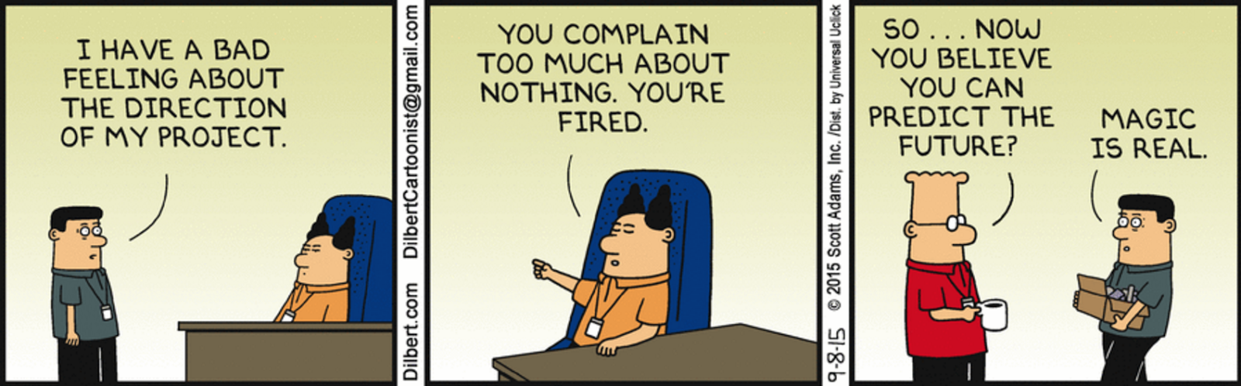
Progressive - aka CONSTRUCTIVE discipline
Discipline/redirection is a critical component of performance management How does it work in your organization?
This Photo by Unknown Author is licensed under CC BY-NC-ND

Slide 21
Think of constructive instead of progressive
Goal in disciplining employees is to avoid having to discipline in the first place
The terminology is changing
Progressive refers to multi-steps
Discipline should be seen as corrective rather than punitive
Focus on changing behavior rather than just punishing it
Provide due process
Safety first

Slide 22
Preventive measures
Review your codes of conduct before implementing
Set clear expectations – with new hires and current staff
Behave consistently – all actions should be based on current policies, procedures and work rules
Establish a climate of communication – make it easy for everyone to have a two-way communication (especially between managers/employees)
Maintain an open-door policy - at every level of the organization
Practice consistent application of performance expectations and redirection actions

Slide 23
Constructive (Progressive) discipline process
Progressive discipline is a process of applying disciplinary actions, moving from less serious to more serious actions, based on the initial severity or repetition of problem behavior
STOP – what does your company’s employee handbook say about disciplinary processes and procedures?
You must follow what your handbook says
Be sure to read it carefully and seek assistance from management, HR or legal advice, if and when necessary

Slide 24
You must consider…
The offense
The relevant policy
The law
The circumstances
The employee
Past treatment of similar problems/situations within company

Slide 25
Discipline handling
INFORMAL ACTIONS
Corrective counseling
Conversation (still documented)
Oral Warning
Documented
Is there a requested action and timeline in this conversation?
What are examples of appropriate oral warnings?
Tardiness
Left the lights on/door open or unlocked
FORMAL ACTIONS
Written warning
Could have more than one
First, second, third, final, last chance
Repetitive violations
Suspension without pay
Safety issue Disciplinary demotion
Result of investigation
Discharge
Every effort has been made to redirect
Severe safety violation
Theft

Slide 26
Performance improvement plan (PIP)
A PIP may result when progressive discipline for performance exists or when observations/prior discussions have occurred regarding lack of proficiency:
This generally happens when the employee is not meeting performance expectations and there is a need to provide additional coaching or training
Has very specific actions
Has a timeline attached (30 to 90 days)
Requires regular feedback and meetings
Has definitive measurements tied to success
Can fall within the formal action processes

Slide 27
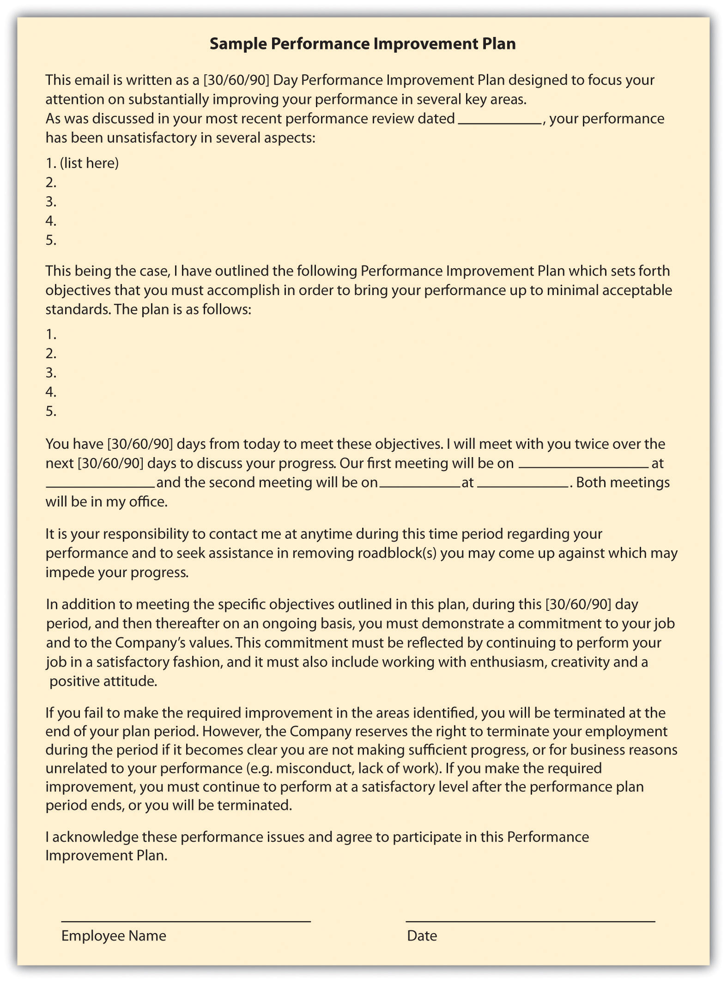
PIP Example
PIP’s are generally for performance improvement; either a skillset or production goal.
Not a best use for attendance or tardiness issues.
This Photo by Unknown Author is licensed under CC BY-SA-NC

Slide 28

Give this some thought Regardless of the type of Performance Management You currently practice:
No Surprises Unless It Is A Gift
Anticipate Behavior And Get Ahead Of It
Behavior That Goes Unchecked Is Condoned
Avoid Management By Telepathy
Perception Becomes Reality
This Photo by Unknown Author is licensed under CC BY

Slide 29
Discussion
Should performance reviews be aligned with pay increases?
Is it more important to be skillful or to get along well with the team?
Do you spend 95% of your time working with/fixing/overseeing/managing 5% of your team?
Do you set clear expectations?
Are you consistent? What gets in the way?
Do you procrastinate the tough conversations?
Script them/write them down

Slide 30
THANK YOU
Cindy Carpenter, SHRM-SCP, SPHR
cc.businessresources@gmail.com
406-871-2574
www.carpenterbusinessresources.com

