Slide 1

AI In Academic libraries
Montana State Library Commission
October 8, 2025
Presenter: Taylor Moorman

Slide 2
What We’ll Cover
01
02
Implications of AI in Academic Libraries
MSU Library GenAI Support
What we won’t cover: Everything.

Slide 3

Taylor Moorman, INSTRUCTIONAL TECHNOLOGY LIBRARIAN
Teaching
Research Skills & Information Literacy
AI Literacy
Research
Integrated, foundational library services
The role of useful technologies to enrich instruction
Folk AI: human-centered critical curiosity in a shifting landscape
Example Projects
AI for Student Guide
OER Textbook for GenAI in Classrooms
Critically Curious
+
Glasgow High School Graduate

Slide 4
GENERATIVE AI
A generative AI system is one that learns to generate more objects that look like the data it was trained on"
(MIT Tech News)
PREDICTION ENGINE TRAINED ON MASSIVE DATASETS

Slide 5
01
Implications of AI in Academic Libraries

Slide 6
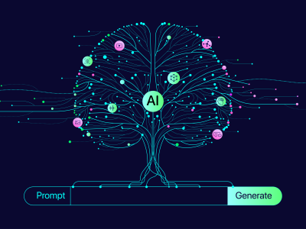
AMPLIFIER OF INPUT
What is repeated?
What is not represented?
Where did the data come from?
Image from:
Brigham Young University. https://genai.byu.edu/genai-training

Slide 7
ECHO CHAMBER IN SOME TOOLS
“That’s a fair point”
“I see where you’re coming from”
“Good challenge”
“Thanks for catching that”
“You’re right to call that out”
WHY?
“Encouragement keeps conversations flowing”
Responses collected from Gemini, Claude, and ChatGPT

Slide 8
CONCERNS OF STUDENT MISUSE
Integrate AI literacy
“If AI feels mysterious and forbidden to students, it could lead to more misuse. Instead, we can inform students about what AI is, how it works, what it does best, and what its limitations are.
Plagiarism aside, generative AI is technology that is likely to affect their futures.”
Common Sense Education: Preventing Plagiarism resource

Slide 9

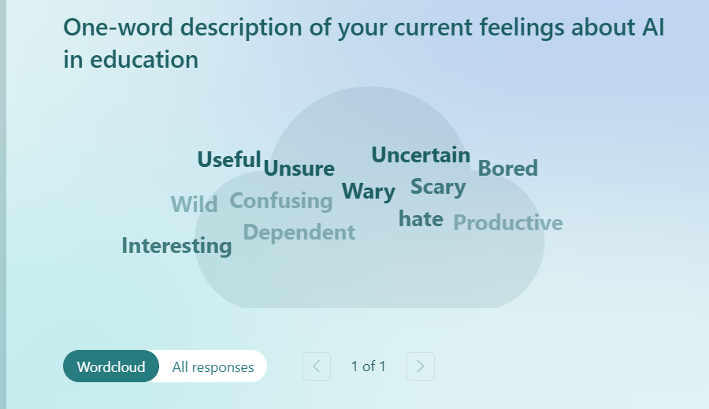

Slide 10
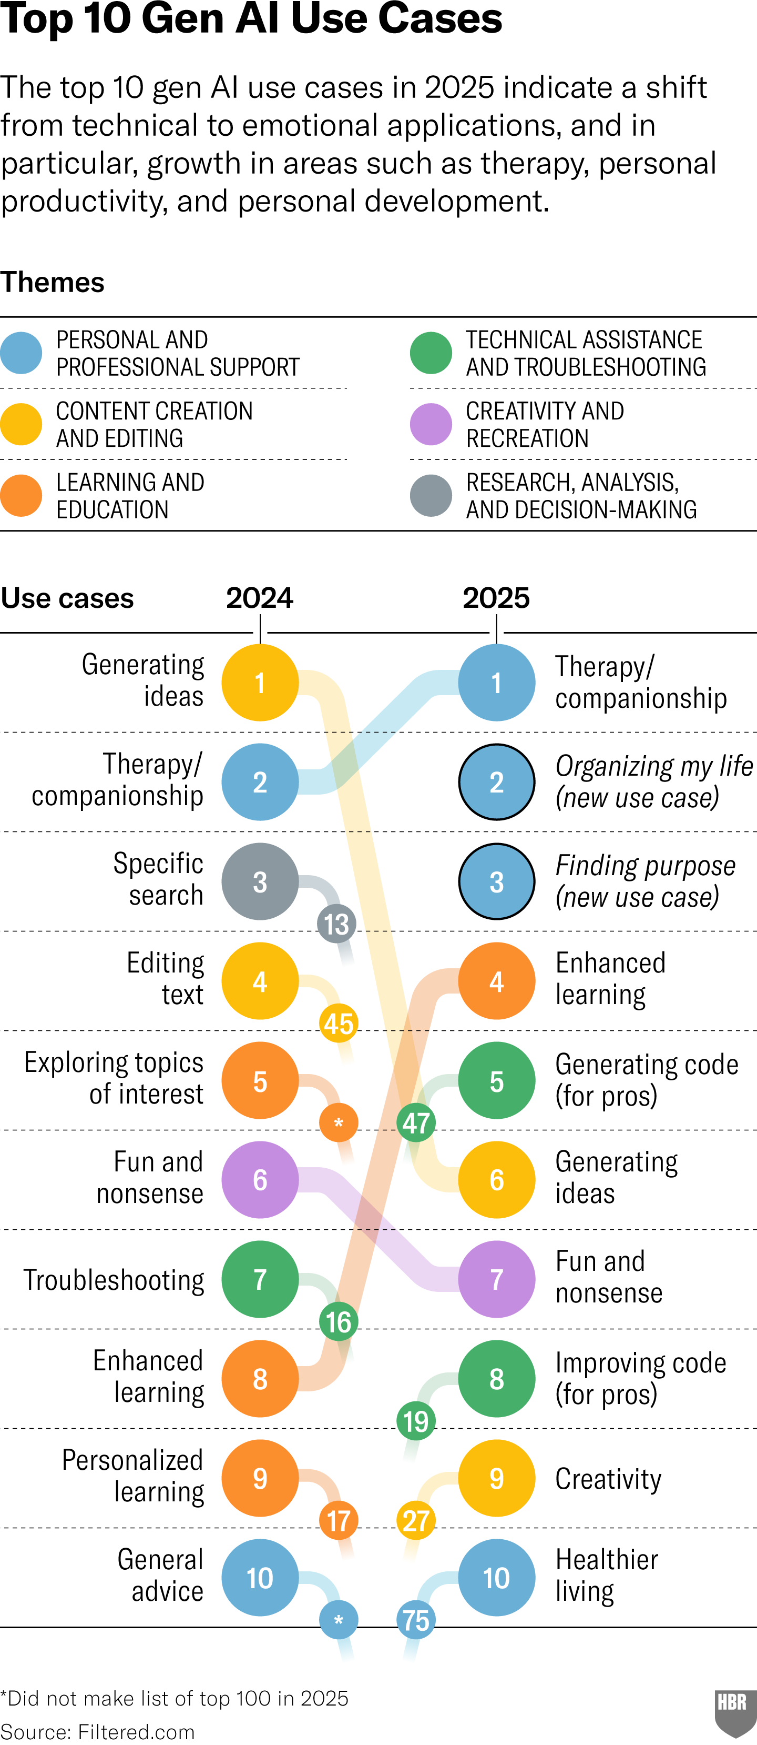
USE CASES
From Harvard Business Review (April 2025) “How People are Really Using GenAI” by Marc Zao-Sanders

Slide 11
USE CASES, Continued
From Harvard Business Review (April 2025) “How People are Really Using GenAI” by Marc Zao-Sanders
WHY IT MATTERS:
How we talk about GenAI in educational contexts can have an impact on other uses of the technology: workplace, civic, and personal communities.

Slide 12
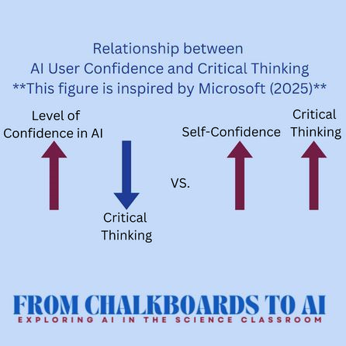
WHY IT MATTERS
Graphic from National Science Teaching Association based on results from these conference proceedings

Slide 13
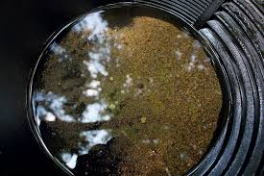
GOLD PANNING STRATEGY
Know what’s real, what’s valuable, & get rid of the excess/waste
Image from:
Petr Hykš. https://www.flickr.com/photos/violetplanet/29974592298

Slide 14
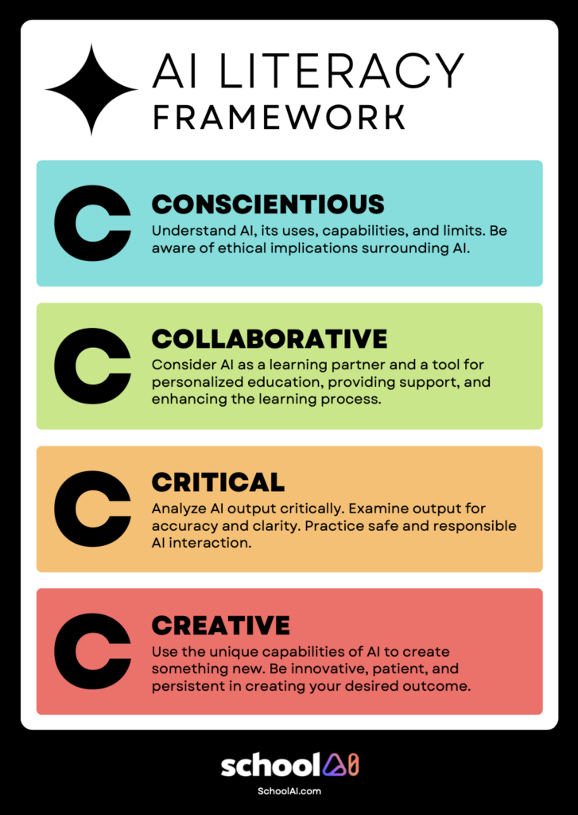
AI LITERACY: 4Cs
School AI’s 4Cs of AI Literacy Framework for Student Success

Slide 15
02
MSU LIBRARY
SUPPORT

Slide 16
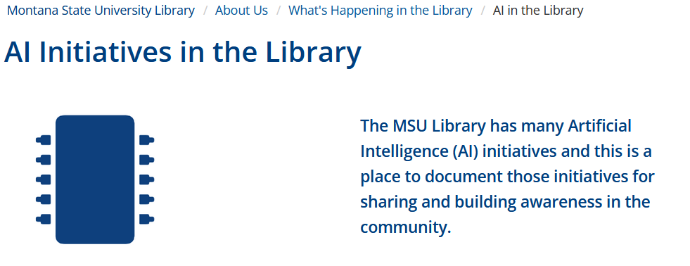
AI INITIATIVES IN THE LIBRARY
https://www.lib.montana.edu/about/whats-happening/ai.html

Slide 17
Open Access Textbook:
An Interdisciplinary Collection of Adaptable Generative AI Assignments and Model Cards
https://scholarworks.montana.edu/handle/1/19220

Slide 18
CREATED BY MANY DISCIPLINES
2 Faculty Librarians
Instructional Designer (Center for Faculty Excellence)
Marketing
Agriculture
English
Nursing
Philosophy
Mathematics
Food Science
Industrial Engineering

Slide 19
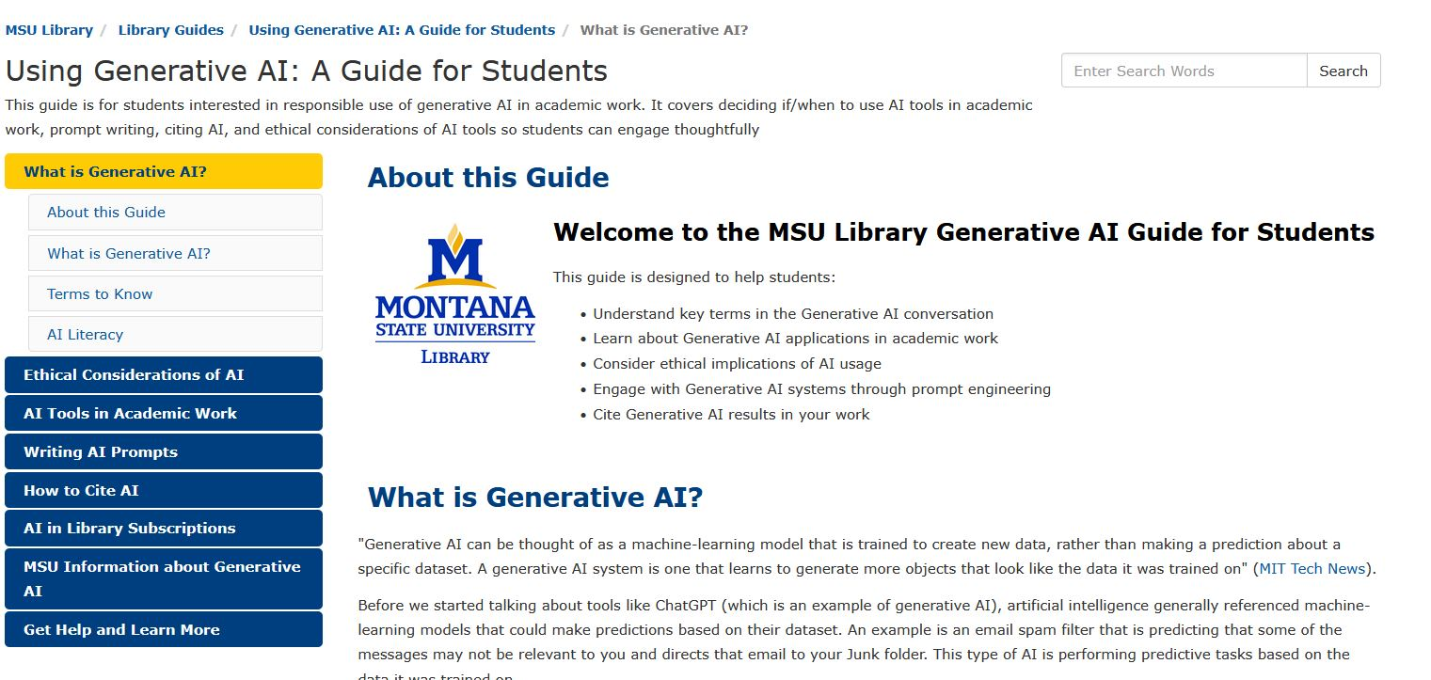
Resource: MSU Library GenAI Guide
https://guides.lib.montana.edu/ai

Slide 20
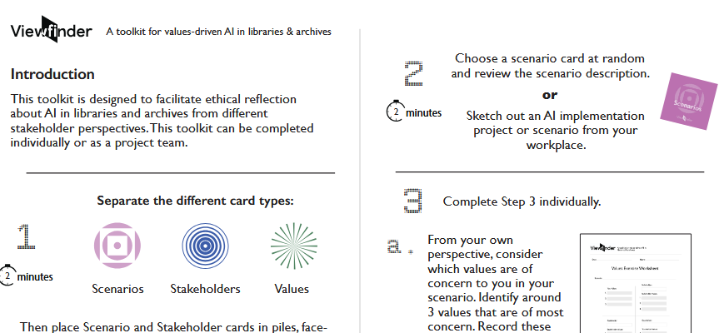
Responsible AI Grant
https://www.lib.montana.edu/responsible-ai/

Slide 21
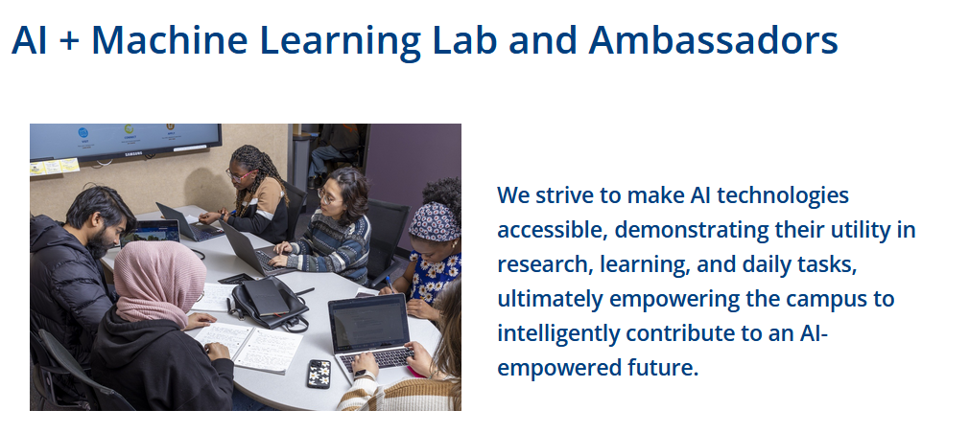
AI + Machine LEARNING LAB
https://www.lib.montana.edu/services/ai/

Slide 22
AI Literacy into Curricula
“The MSU Library is the lead in participating in an Ithaka S+R cohort in 2025 that "will, with 58 other cohorts across North America, work to identify how libraries and other university units can weave AI literacy into their existing operations, leveraging programs or initiatives that center on information, digital, or metaliteracy."
https://sr.ithaka.org/blog/integrating-ai-literacy-into-the-curricula/

Slide 23
Strengthening human communities/knowledge
IF/WHEN engagING with this technology
WHY IT MATTERS

Slide 24
THANK YOU!
Questions welcome.
Taylor Moorman
taylor.moorman@montana.edu

