Slide 1
Tiny Tech Training
New Year New Learning - Universal Class
January 30, 2024
Notes:
Hi everyone,
Welcome to todays Tiny Tech Training in the MSL Learn series. I am accompanied by Colet Bartow our CE coordinator who will be helping to moderate and make sure you get your evaluation link at the end.

Slide 2

Today we will cover:
Accessing Classes
Claiming CE Credit
Demand for training

Slide 3

Notes:
With an increasing demand for computer literacy training, we wanted to spotlight UC in the new year. You can claim UC credits 1:1 in ASPeN if you and your supervisor determine that they apply to your role at your library.
How many of you have taken a Universal Class? (Start Poll)
In the Polls/Quizzes window, click the name of the poll to open the details.
Click Launch.
The participants in the meeting will now be prompted to answer the polling questions. The host will be able to see the results live.Once you would like to stop the poll, click End Poll.

Slide 4
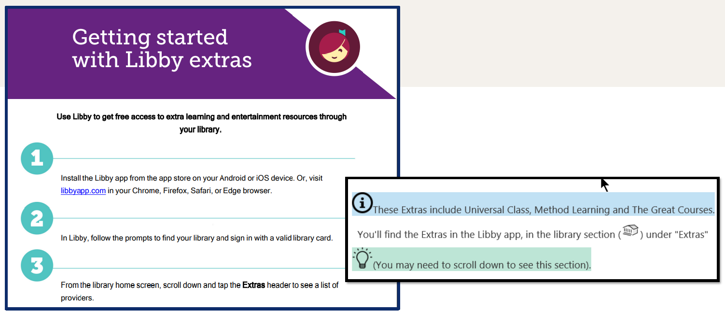
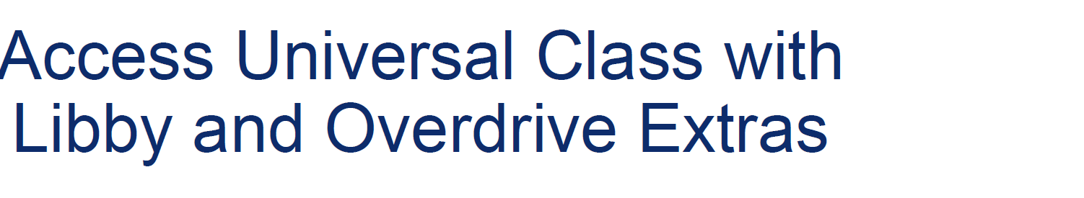
Notes:
To get started in Universal Class you can follow these steps! I am putting a link to this printable in the chat. http://tinyurl.com/mrxt9ar5

Slide 5
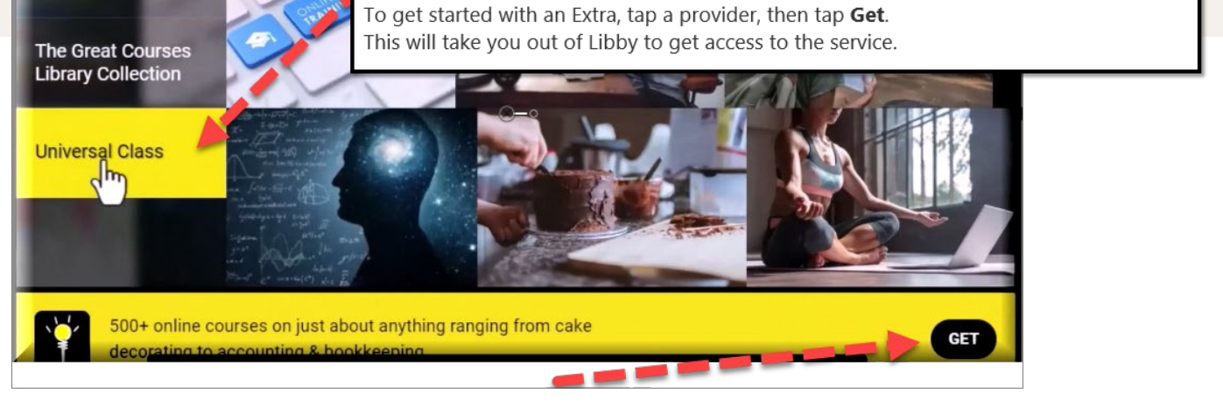
Notes:
Once you are in the Libby app you can find the access portal to Libby about halfway down the list of collections. You will click Universal Class and then click ‘Get’ to check it out.

Slide 6
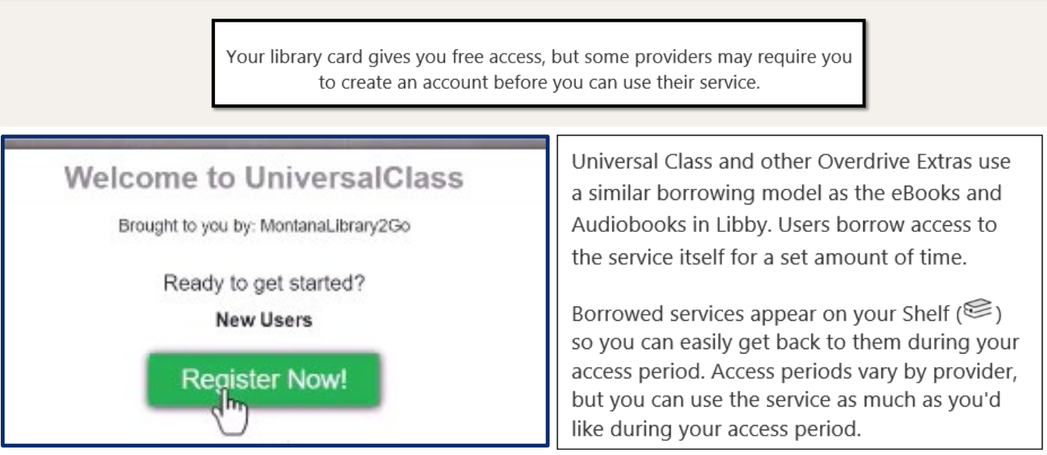

Slide 7
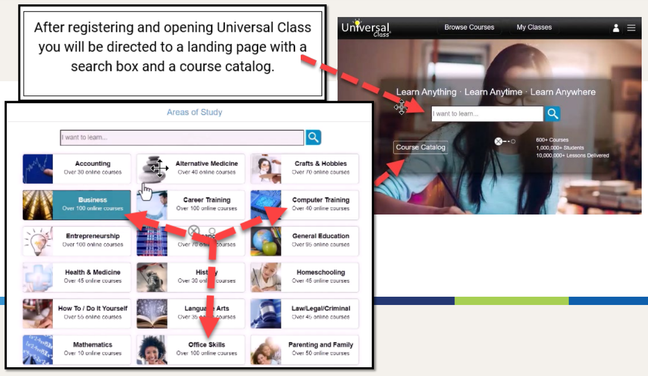
Notes:
This is also available for your patrons so while you might be drawn to some of the business, computer or office skills, it is good for you to know how to get around in there to access other things like hobbies, DIY or general education.

Slide 8
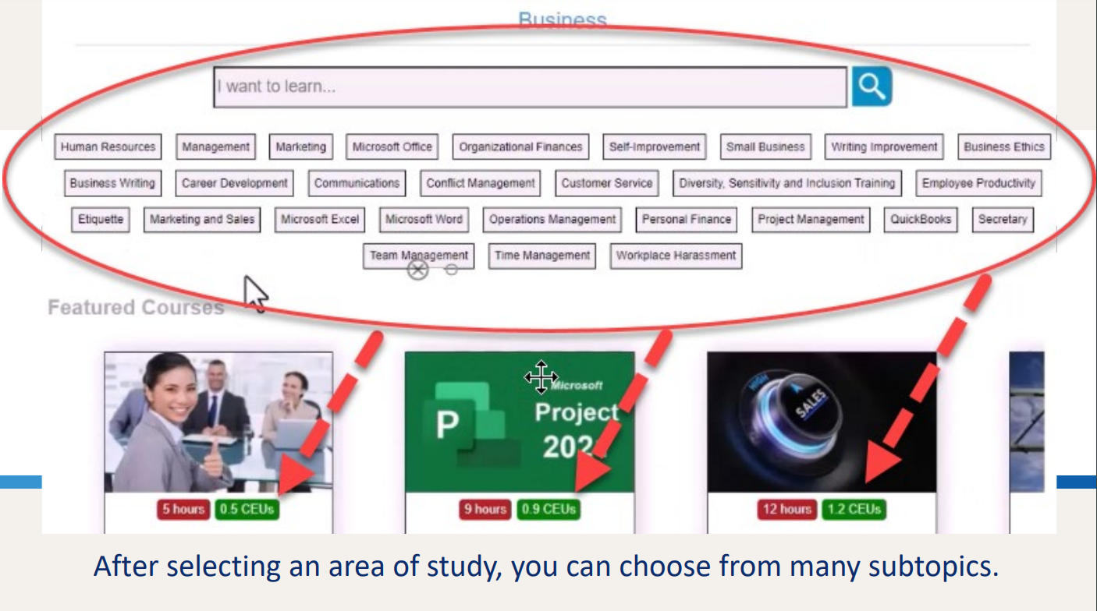
Notes:
You can also do a general search to narrow it down and see featured courses.

Slide 9
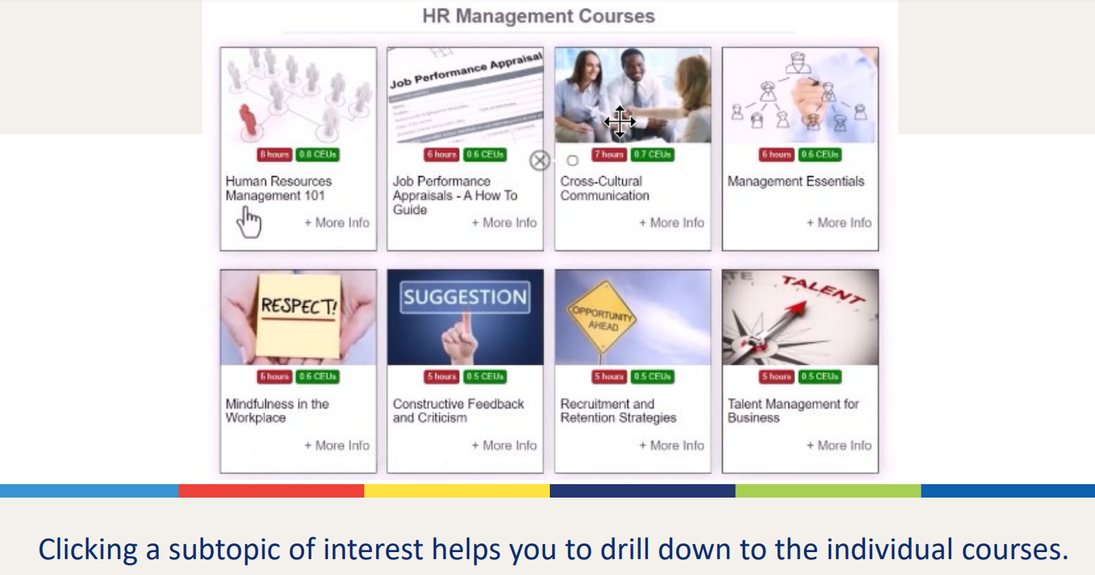
Notes:
When you select a category you will be able to see all of the courses available in this area of study.

Slide 10
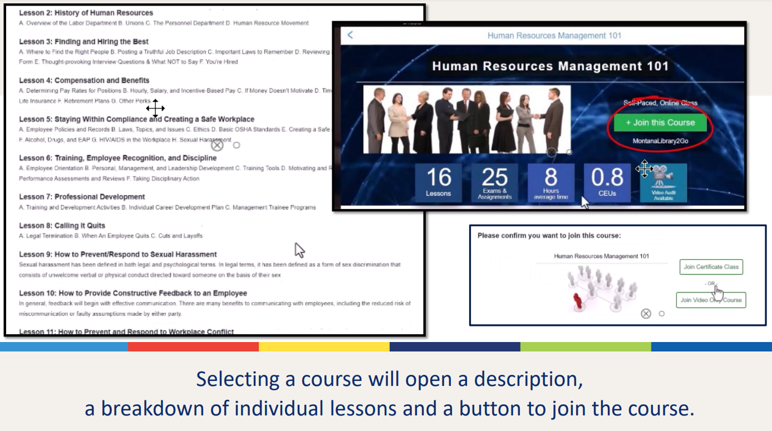
Notes:
Then when you open a course you will see all of the lessons in a topic. Click the green button to join the course and start working through the lessons.

Slide 11
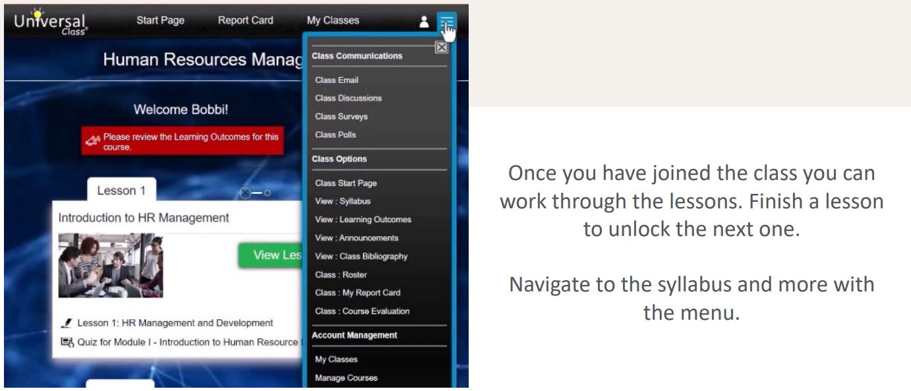
Notes:
You can get around within a course with the dropdown menu, and navigate the syllabus. This is also where you can see your report card and learning outcomes.

Slide 12
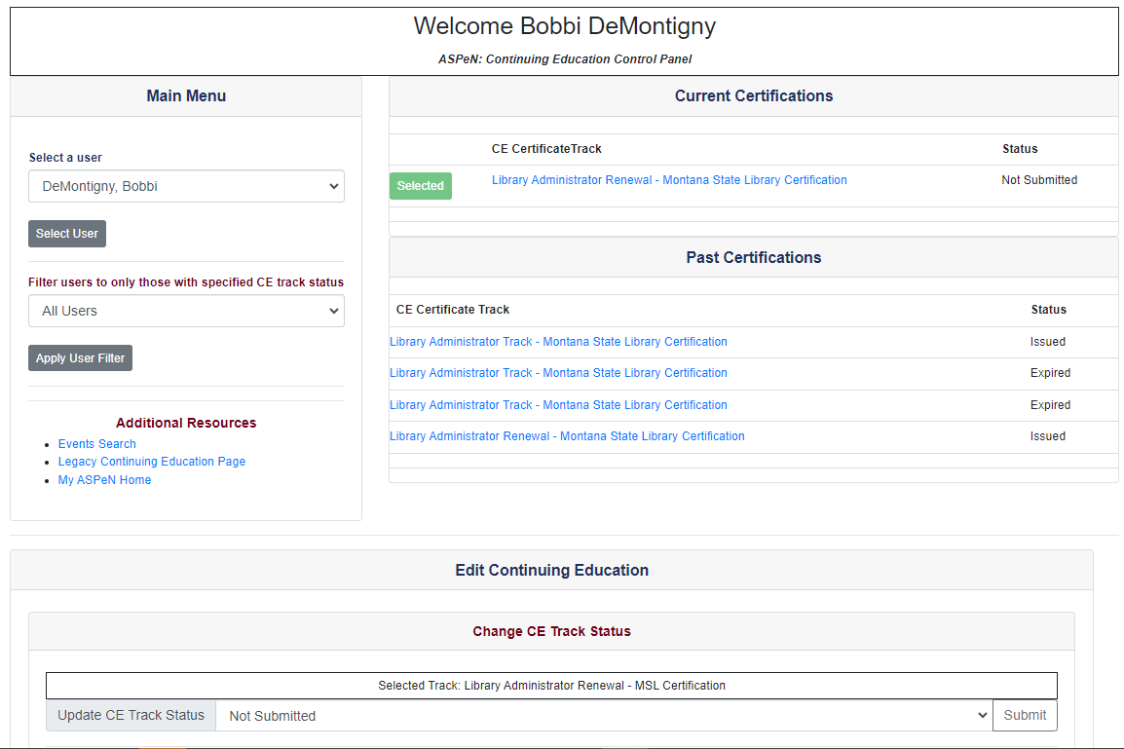
Notes:
Then you add your new CE as an independent learning event.

Slide 13
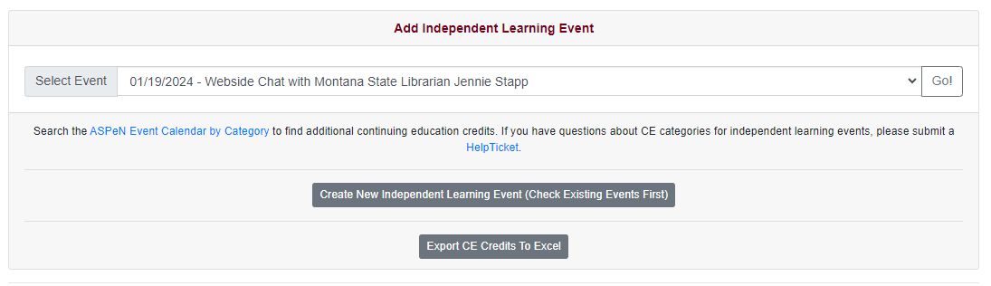
Notes:
Add an independent learning event.

Slide 14
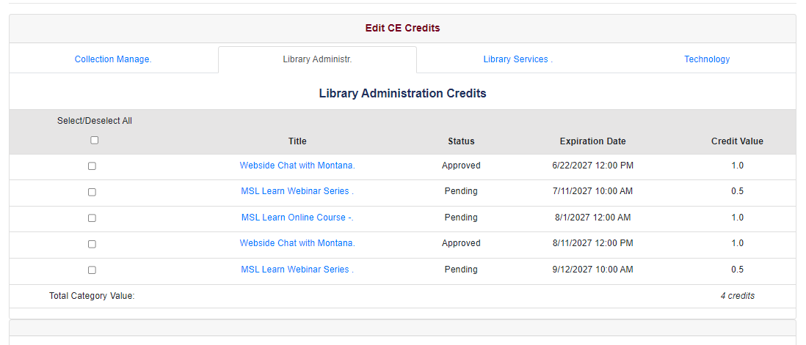
Notes:
You can see your credits by clicking each tab to see your classes.
Now we can go through those steps together.
(Libbyapp, log in, ask them to name a work related topic they would like to know more about – see what we can find and then look at the class.
Then navigate away from that and go to personal development, assertiveness, show hours and lessons. The slowly scroll all the way down) go through the beginning of a lesson, then explain that they need to fill out an independent learning event when they have finished. Take them to ASPeN and complete an independent learning event all the way to the end but don’t click save. Then navigate away and show them where it would show up if I had completed it.

Slide 15
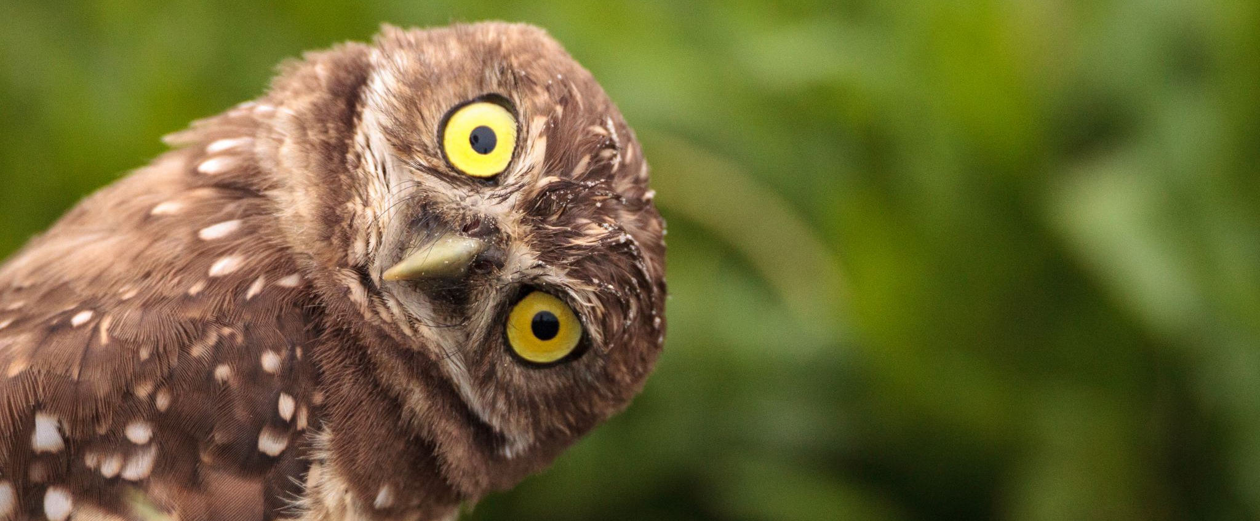
Questions?
Notes:
Do you have any questions

Slide 16
Help and resources
MSL Knowledge Base articles
Notes:
This recording will be available on our YouTube channel, we have our Knowledge base articles available, or if you saw something today that you need additional help with, I encourage you to open a Helpdesk ticket!
Finally, I also want to encourage you to fill out your evaluations at the link Colet is adding to the chat.

Slide 17
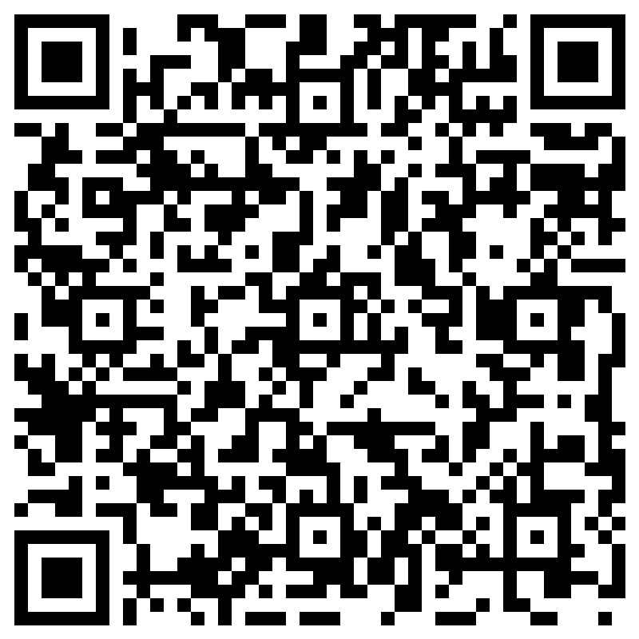
Let us know how we did today!

Slide 18
Need a little extra time?
Notes:
The presentation is done, but I try to hang around a little longer in case anyone needs some one-on-one help while I have screen sharing capabilities up.

