Slide 1

Tiny Tech Training
Web-based Connexion is going away - don’t be scared.
October 31, 2023
Notes:
Good morning, and welcome to the October Tiny Tech training! I am Bobbi deMontigny and with me I have Laura Tretter, Sys Admin for the Montana Shared Catalog and Colet Bartow, our CE Coordinator.
Last month we discussed OCLC as a sort of an overview. We went over the OCLC contract, what it currently includes, and what that might look like to a patron using worldcat to find material.
Today Laura is going to talk to us about Connexion, and what it means for our libraries now that OCLC is discontinuing it.

Slide 2
Welcome!

Slide 3

Agenda
Intro
What is Connexion
How does it apply to me?
What does it all mean?!
Notes:
This is the agenda for todays topic

Slide 4
OCLC Group Services Contract
Includes:
Unlimited cataloging
Unlimited interlibrary loan
Access to WorldCat
Principles of Cooperation:
Contribute the items from your collections to OCLC
Create bibliographic records to the fullest level possible using OCLC standards
Contribute created records to OCLC
Identify and correct errors in bibliographic records and avoid adding duplicate records
Limit use of OCLC, systems, and services to OCLC authorized users

Slide 5

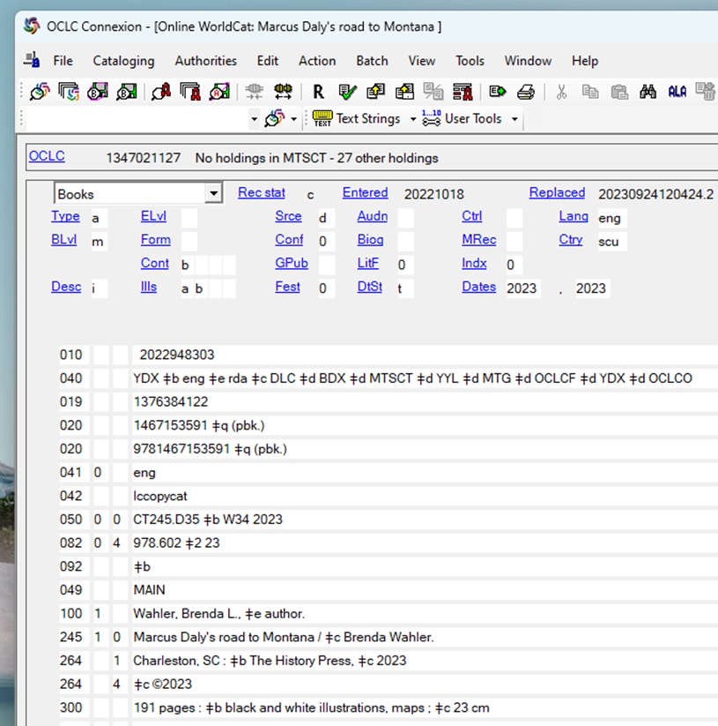
What is Connexion?
Connexion is a full-service cataloging tool offered by OCLC.
Using Connexion, you can create and edit bibliographic and authority records and then share them with the entire OCLC cooperative to benefit libraries around the world.

Slide 6
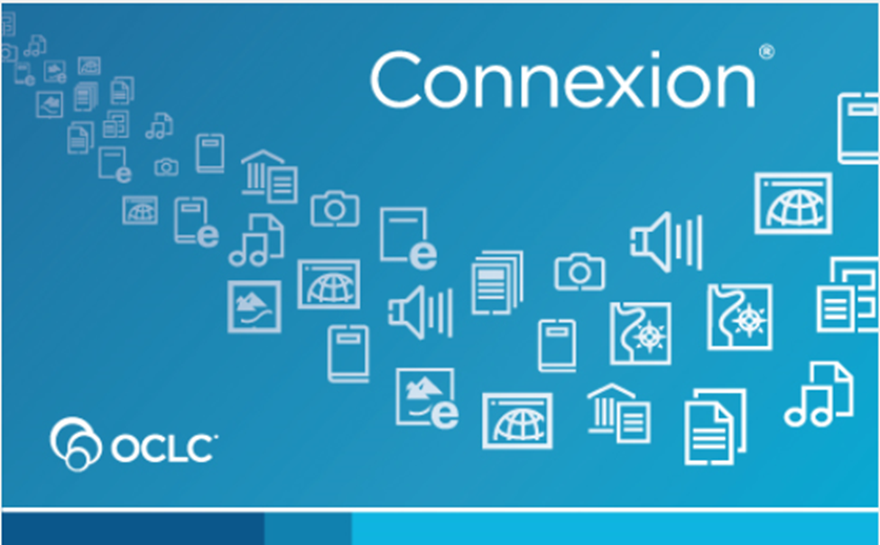
‘Connexion’ currently includes
• Connexion Client
• Connexion Browser
• CatExpress

Slide 7
‘Connexion Browser to be discontinued April 30, 2024’ *This includes CatExpress

Slide 8

Starting May 1, 2024
• Connexion Client
• Connexion Browser
• CatExpress
• WorldShare Record Manager

Slide 9
What do I need to do?
If you use Connexion Client to enhance bib records or to perform original cataloging: nothing
If you use Connexion Browser or CatExpress to enhance bib records or to perform original cataloging: you have a decision to make

Slide 10
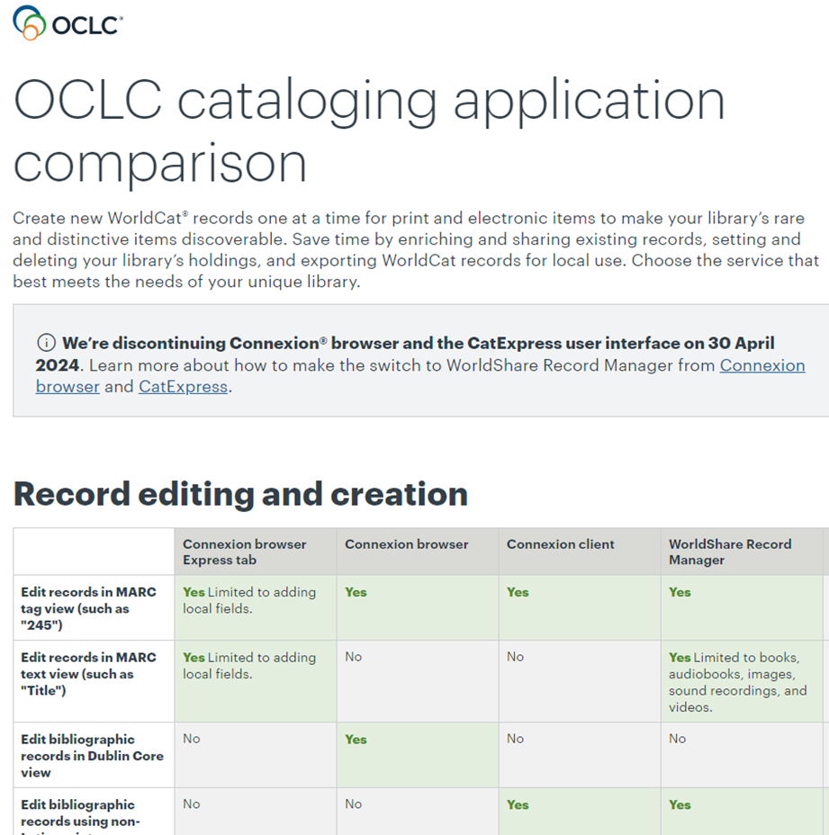
Connexion Client or WorldShare Record Manager?

Slide 11
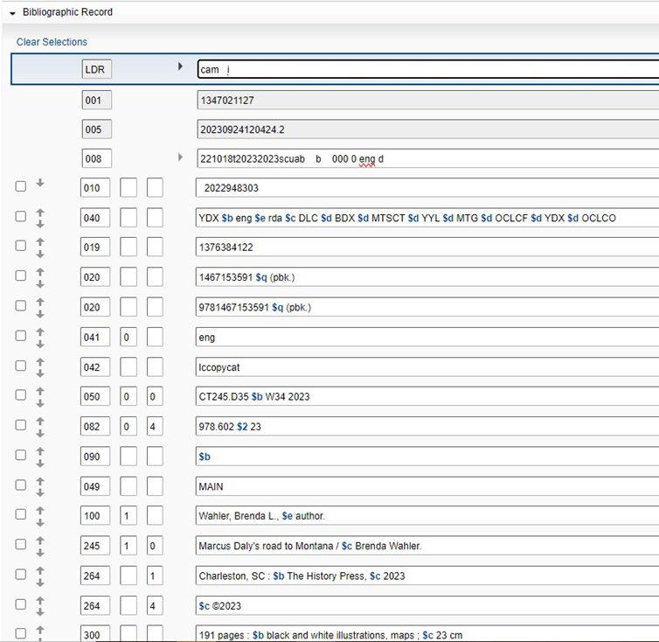
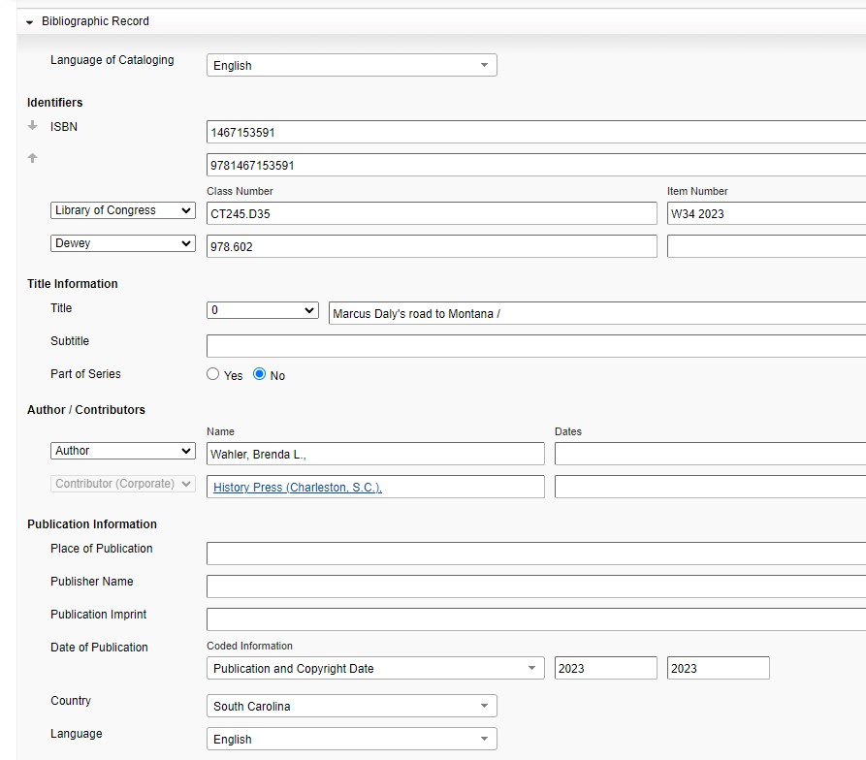
Record Manager – MARC view
Record Manager – Text view

Slide 12
I've made my decision!
I want to use Connexion Client:
Download the client using the download link from OCLC documentation
Use your existing Connexion login authorization
Watch OCLC training videos and review documentation
I want to use Record Manager:
Get the login link for WorldShare from OCLC documentation
Use your existing WorldShare login credentials or request credentials from OCLC. May also need to request your WorldShare roles to include cataloging
Watch OCLC training videos and review documentation

Slide 13
OCLC cataloging application comparison chart: compares the features and functionality of CatExpress, Connexion Browser, Connexion Client, and WorldShare Record Manager Comparison of Connexion Browser and Record Manager actions: compares common actions and the steps to perform those actions in Record Manager vs Connexion Browser Make the switch to WorldShare Record Manager: highlights of the software, 20-minute demonstration video, login link and contact form to request credentials, links to documentation and training WorldShare Record Manager: overview of the software, 10-minute demonstration video, links to documentation and training Connexion Client: overview of the software, link to download the client, links to documentation and training
Resources
Notes:
OCLC Cataloging application comparison chart: https://www.oclc.org/go/en/oclc-cataloging-application-comparison.html
Comparison of Connexion Browser and Record Manager actions: https://help.oclc.org/Metadata_Services/WorldShare_Record_Manager/Transition_from_Connexion_browser_to_WorldShare_Record_Manager/Comparison_of_Connexion_browser_and_Record_Manager_actions Make the switch to WorldShare Record Manager: https://www.oclc.org/go/en/connexion-migration-ws-record-manager.html
WorldShare Record Manager: https://www.oclc.org/en/worldshare-record-manager.html
Connexion Client: https://www.oclc.org/en/connexion.html

Slide 14
Discussion and Questions

Slide 15
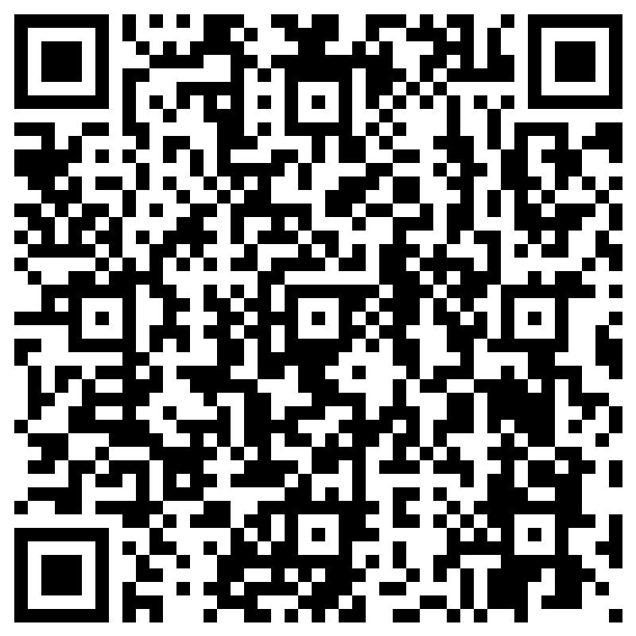
MSL Evaluation Survey
https://forms.office.com/g/ffUuzbA8gn
Notes:
https://forms.office.com/g/ffUuzbA8gn

Slide 16
Thank you for joining us!

