Slide 1
MSL Learn Webinar Series
March 14, 2023

Slide 2
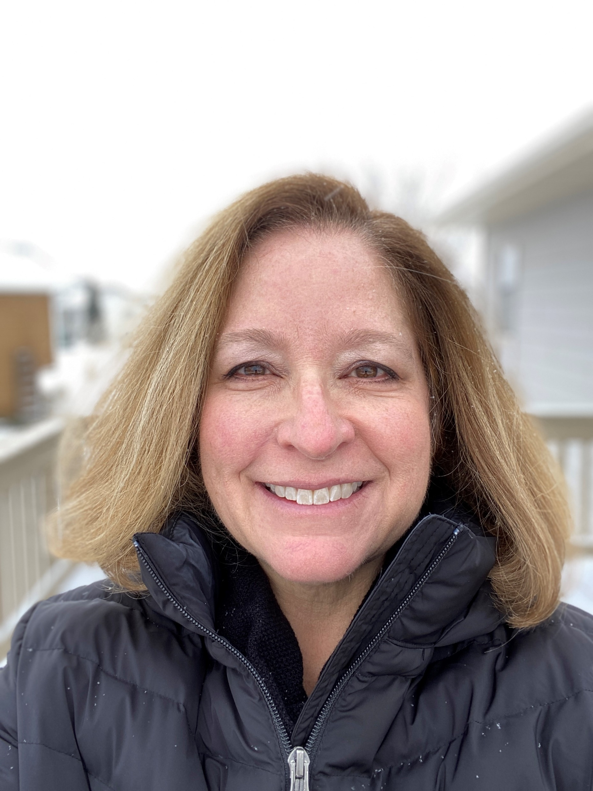
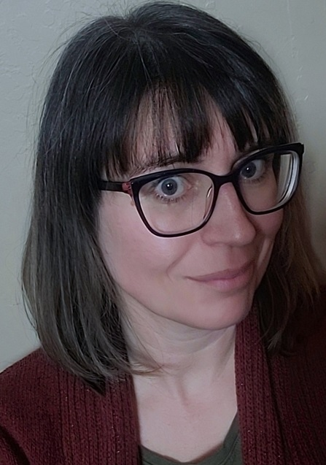
Today’s Hosts
Colet Bartow
Bobbi DeMontigny
MSL Continuing Education Coordinator
(Colet rhymes with Olay)
Montana Library Network Technical Support

Slide 3

Today’s Agenda
Purpose
Plan
Resources
Notes:
Establishing a predictable and reliable schedule of short online sessions will
help potential participants plan continuing education;
provide timely and regular updates on MSL programs; and
provide regular opportunities for MSL staff to get feedback from participants.

Slide 4

MSL Learn Webinar Schedule
Join us each month!
Second Tuesday
MSL Programs and Topics
Last Tuesday
Tiny Tech Training
Notes:
30-minute sessions on the second Tuesday of each month on general topics of interests to directors, trustees, and staff
30-minute sessions on the last Tuesday of each month – Tiny Tech Trainings
Go to the ASPeN Event Calendar to see the full schedule and register for upcoming sessions. Use the search phrase “MSL Learn” to see a list

Slide 5
ASPeN
Notes:
ASPeN stands for: Access to Services, Programs, and eNetworks.
This product provides a variety of services for Montana's library community. Members of the public can search ASPeN to find a nearby library or learn more about their local library.
Library Directors, Trustees, and staff can login to ASPeN to do much more based on your level of administrative responsibility within your institution.

Slide 6
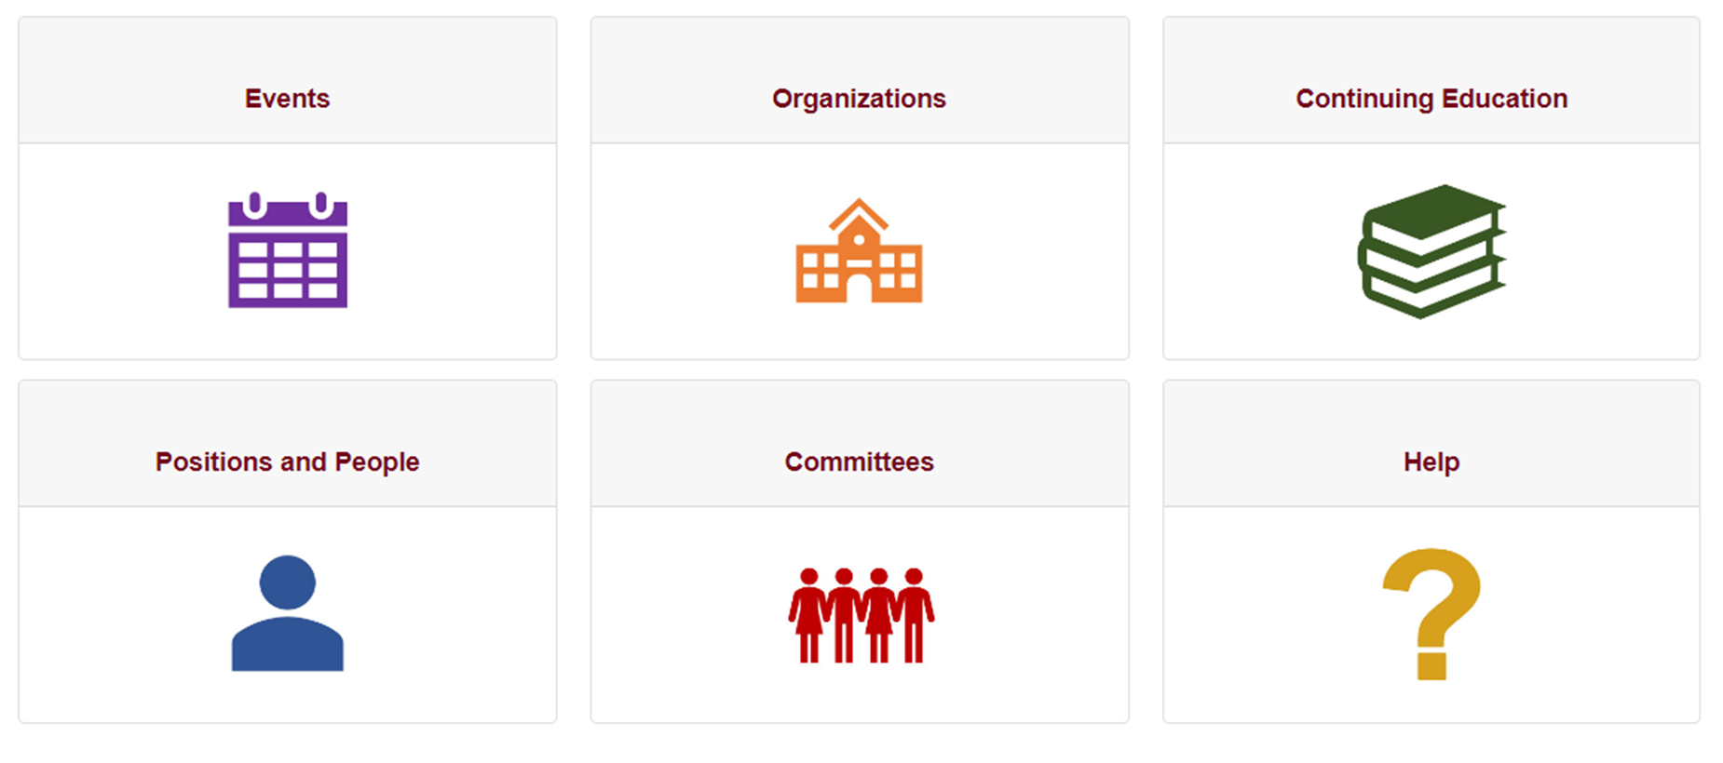
https://mslservices.mt.gov/aspen/

Slide 7
Where to get help
Notes:
It is easy to get help with ASPeN.
This is done by opening a helpdesk ticket. Our helpdesk ticket system is monitored regularly, and someone, (probably me!) will usually respond soon.
It is best to open a ticket rather than send an email to an individual because there are back up people available to monitor tickets in case the primary technical support person is not available.
You can open a ticket from multiple access points:

Slide 8
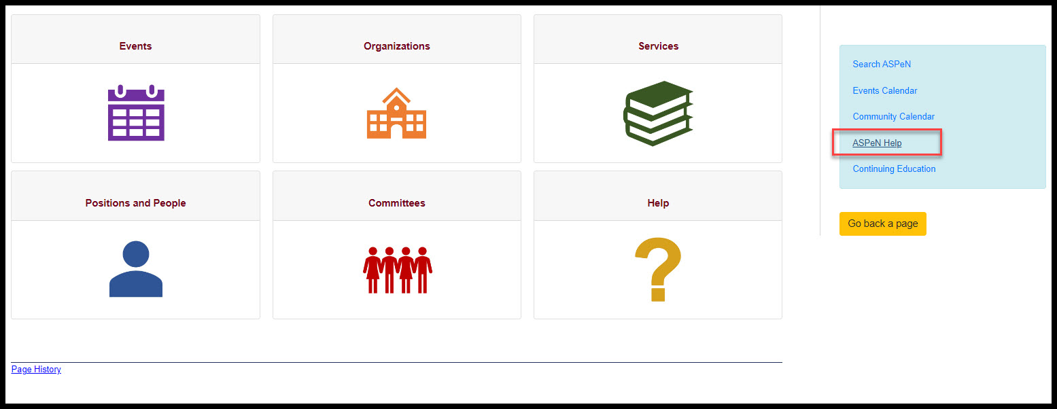
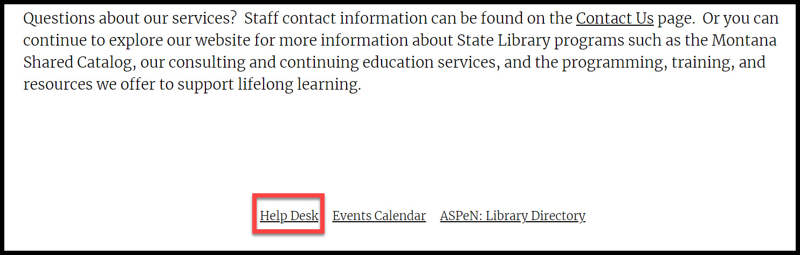

Slide 9
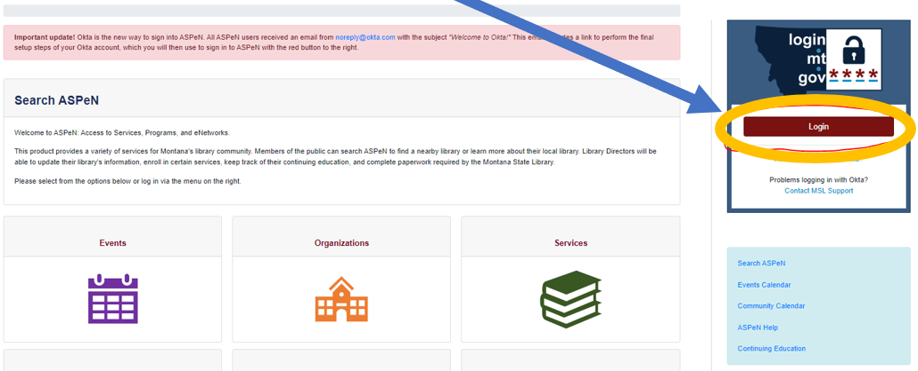
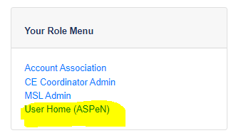
Log in to ASPeN
Notes:
It has been a while now but if you were not aware, the state shifted its authentication from ePass to OKTA. Everyone in ePass would have received an email about this a long time ago. If you did not use the activation link provided in that email your ASPeN credentials might not work correctly anymore. The best way to learn if you have a working login credential is to try logging in. If you see User Home under your Role menu, you are probably in good shape. If you don’t you might have to open a ticket.

Slide 10
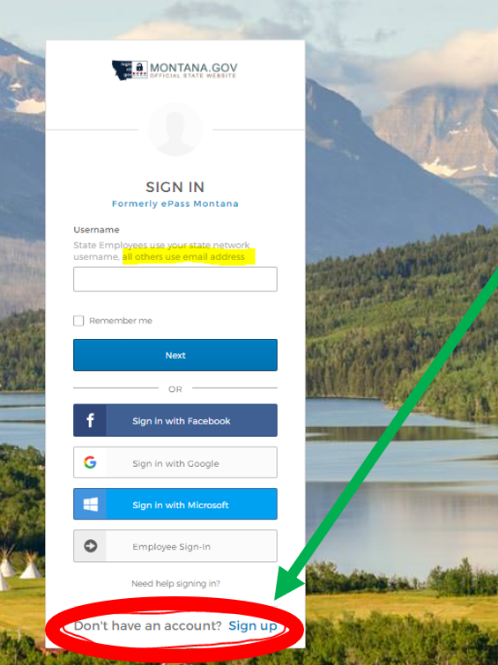
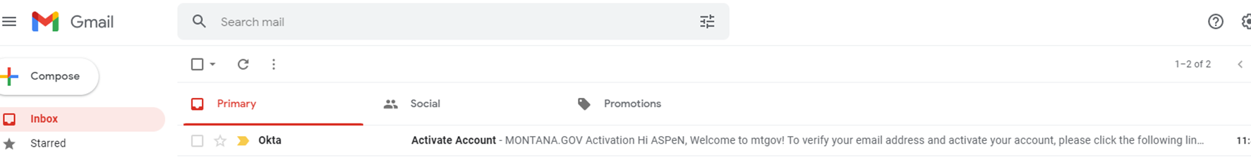
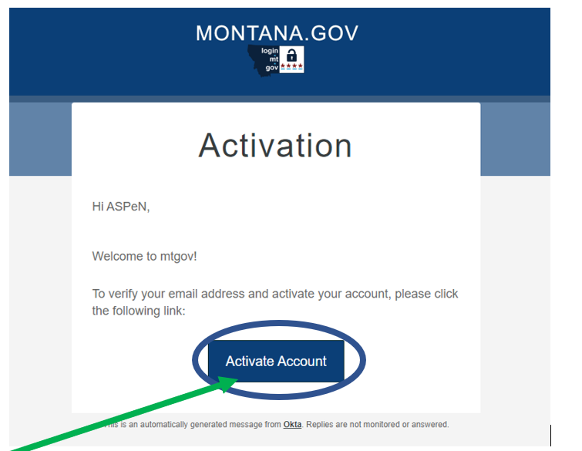
2.
1.
3.
4.
Notes:
Trouble logging in for the first time? Here are the steps.

Slide 11
Set up an ASpeN Account and log in!

Slide 12


These are the things I think everyone should know how to do in ASPeN.
Visit the ASPeN Knowledge Base
Open a help desk ticket
Update your information
Get to know the Events Calendar
Register for an event
Find supplemental meeting materials
Select a Continuing Education Track
Add Continuing Education Credits
Search ASPeN for organizations and people
Try out the Legacy Search option
Look at the different committees
Notes:
Is there anything on this list you didn’t know about, is there anything you have never done before? We are happy to help, and there is a course in progress in MSL Learn that can help. I would love to see that become part of the onboarding process for new staff.

Slide 13
Directors should be able to:
Add employees
Remove employees
Change employees position information
Add library images
Change library hours
Change Trustees and board members
Notes:
You can also request a designee be given permissions to do some of these things. Just open a helpdesk ticket and ask me to give staff members the permissions.

Slide 14
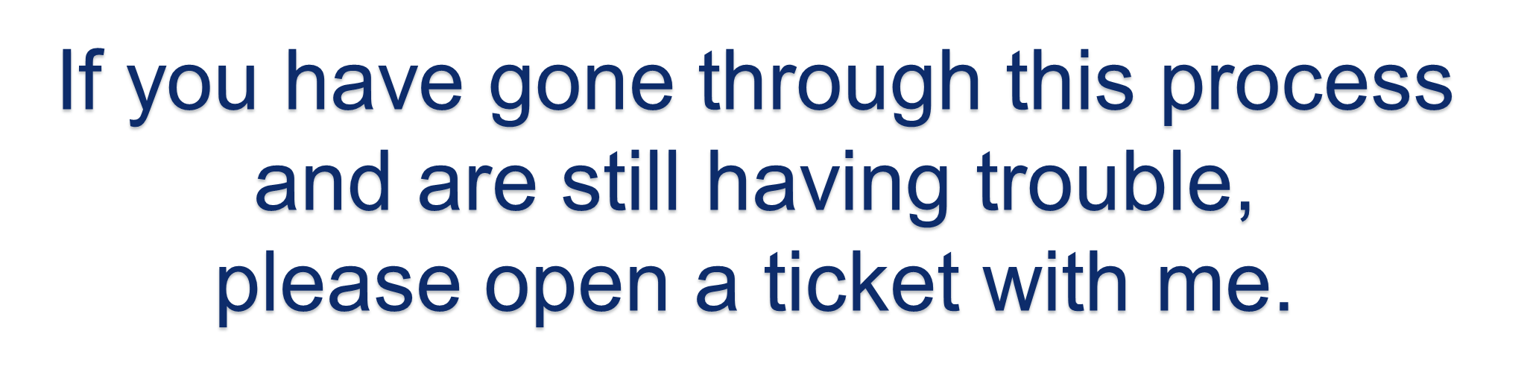

Slide 15
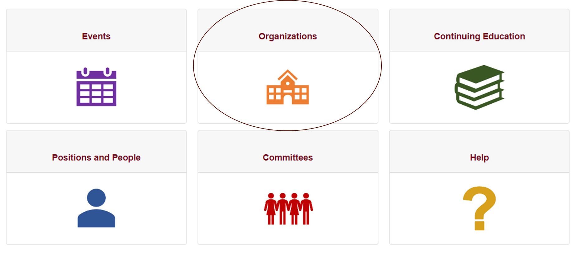
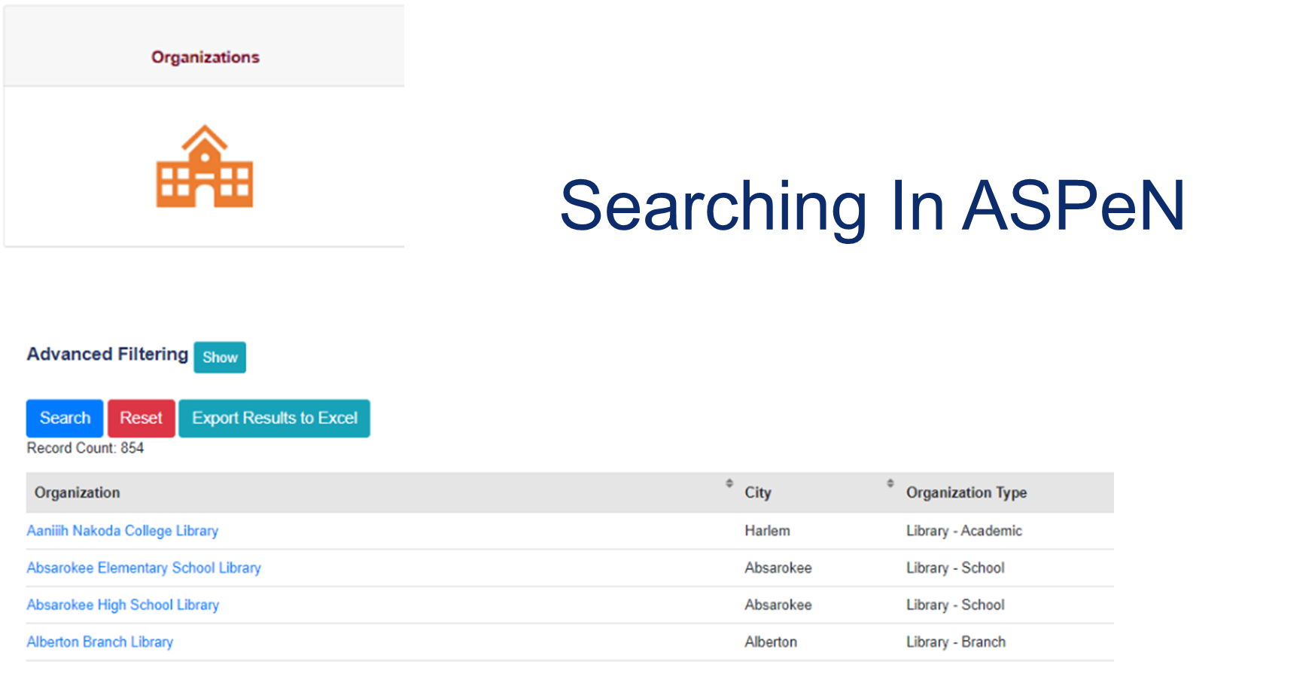

Slide 16
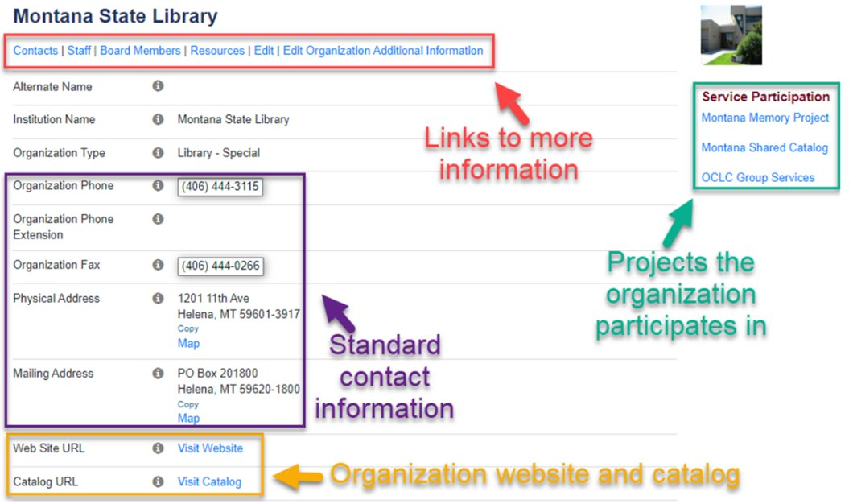

Slide 17

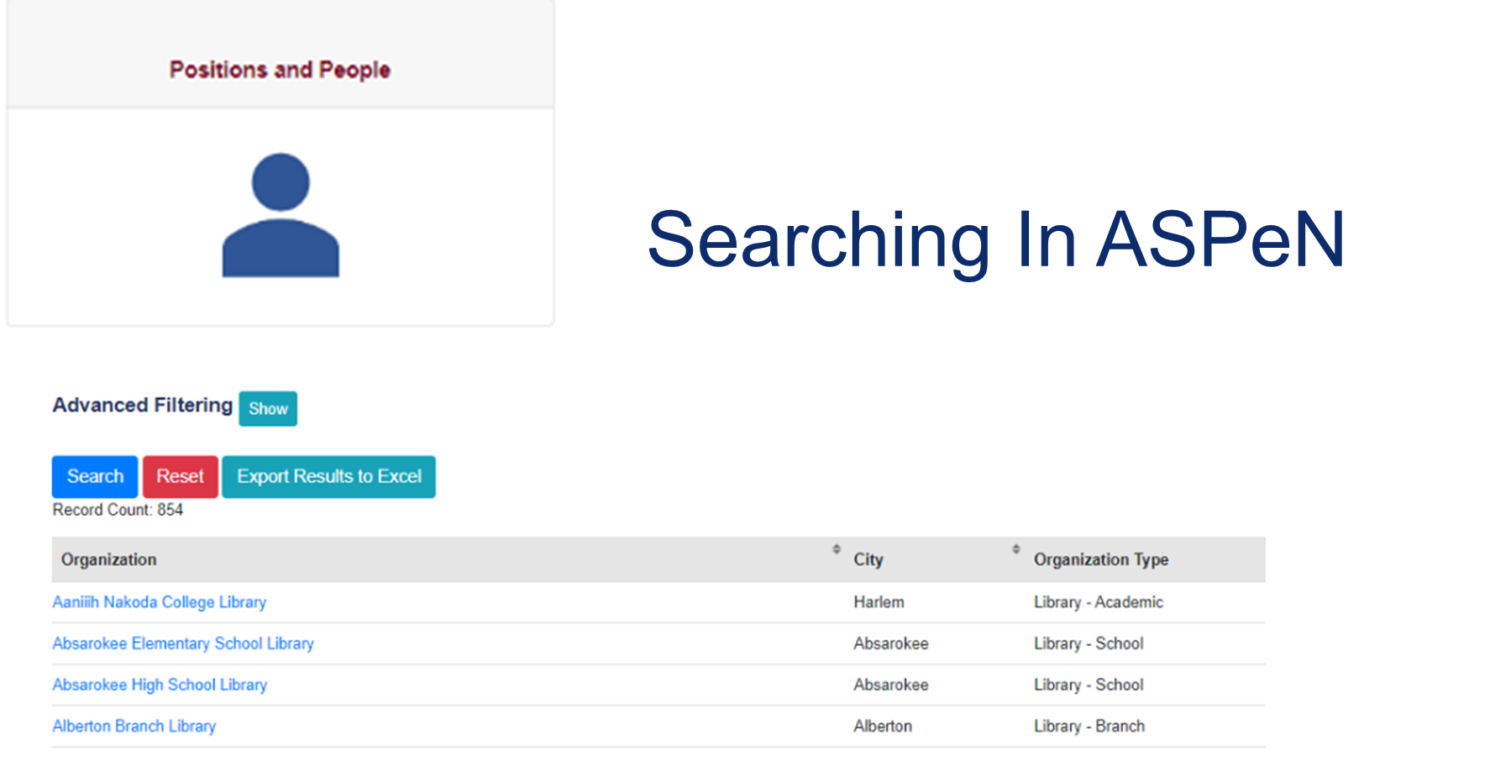

Slide 18
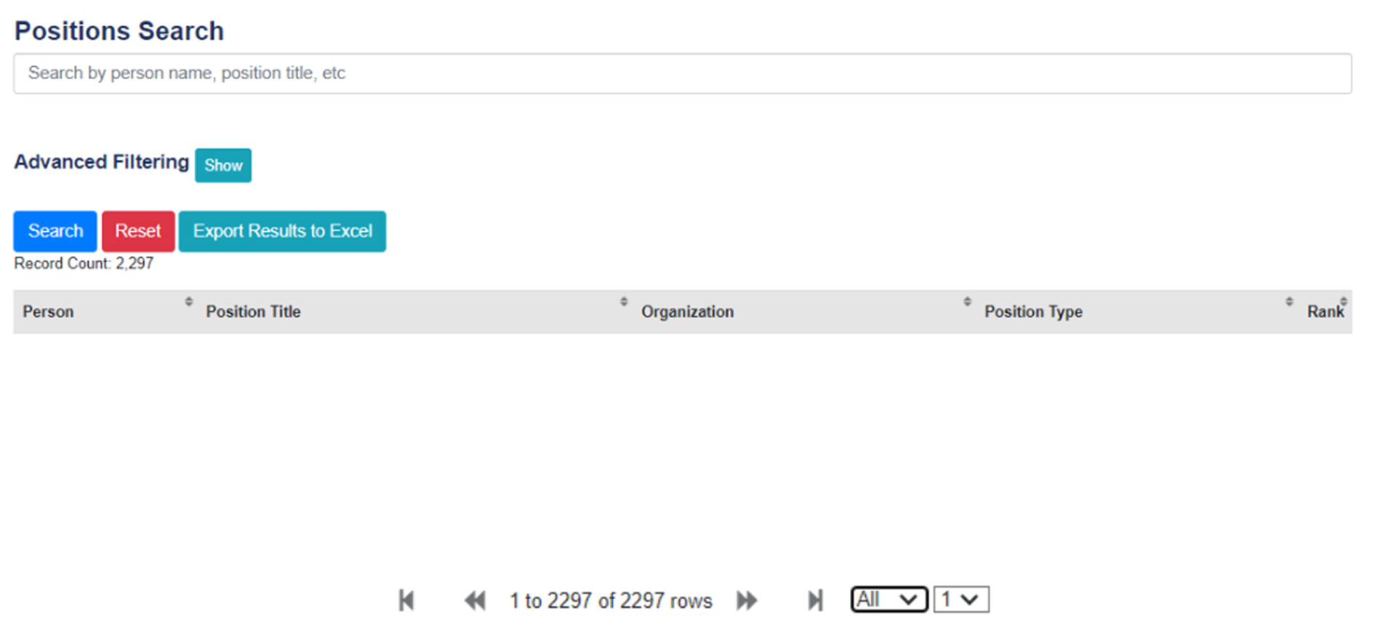

Slide 19
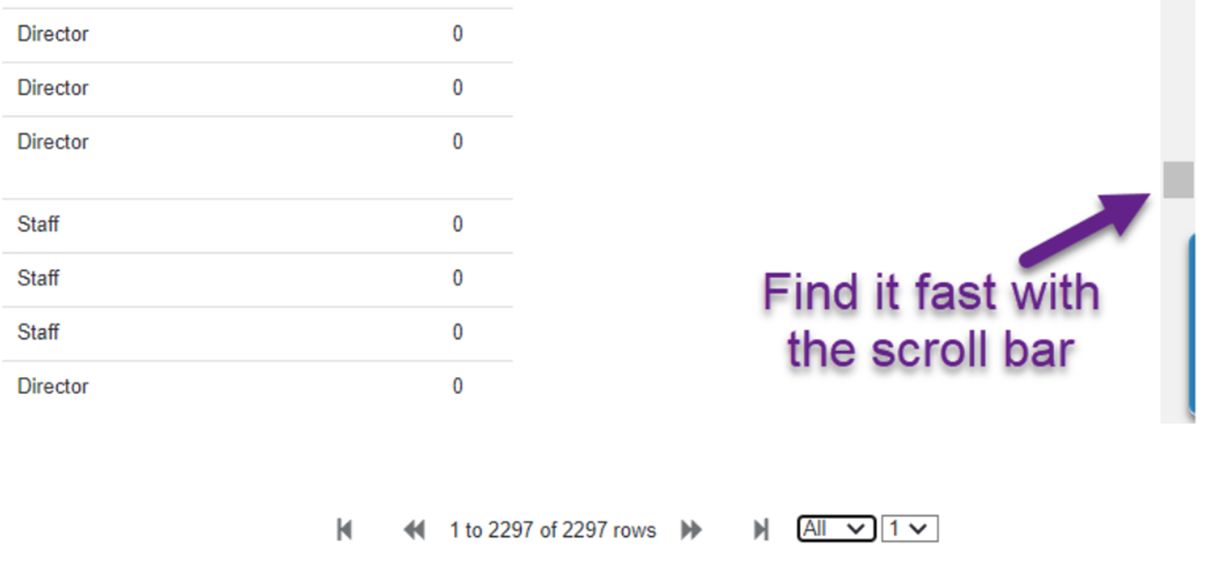

Slide 20
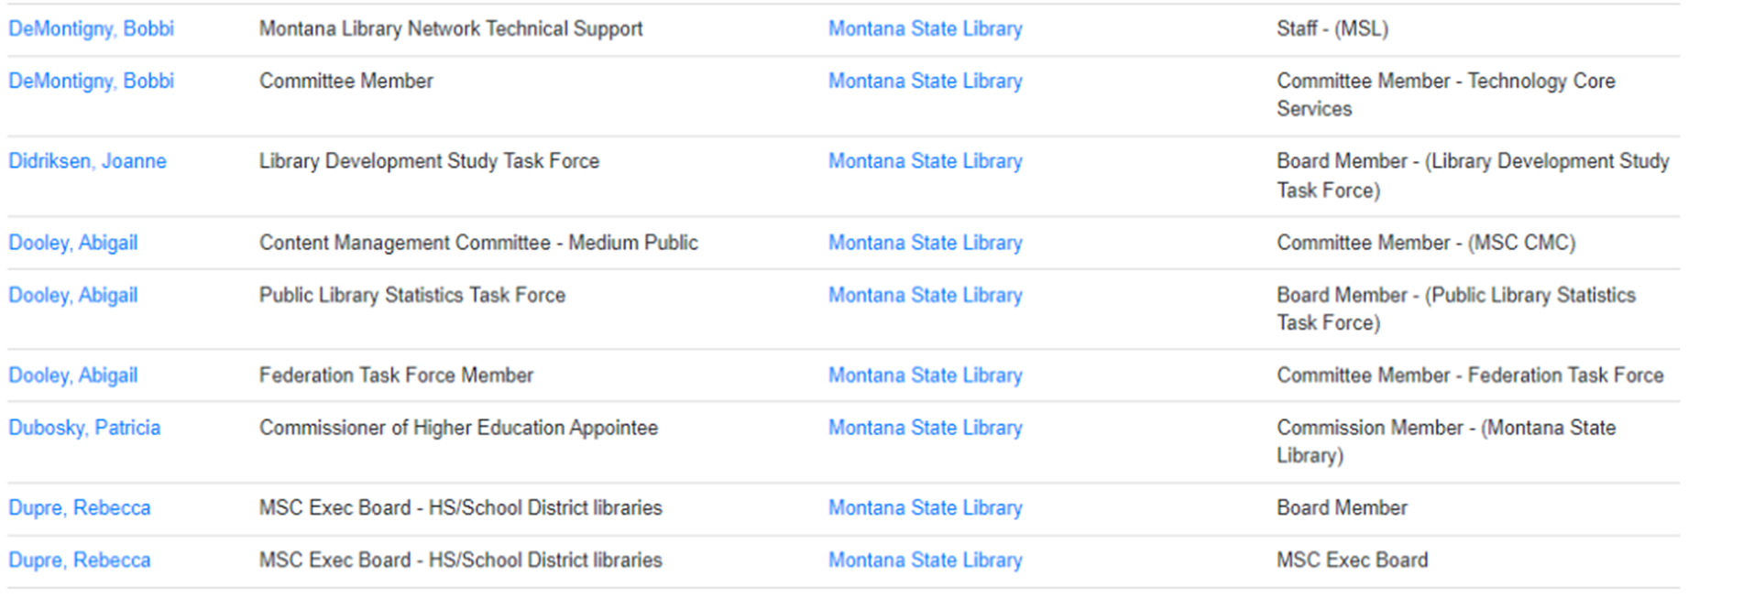



Slide 21
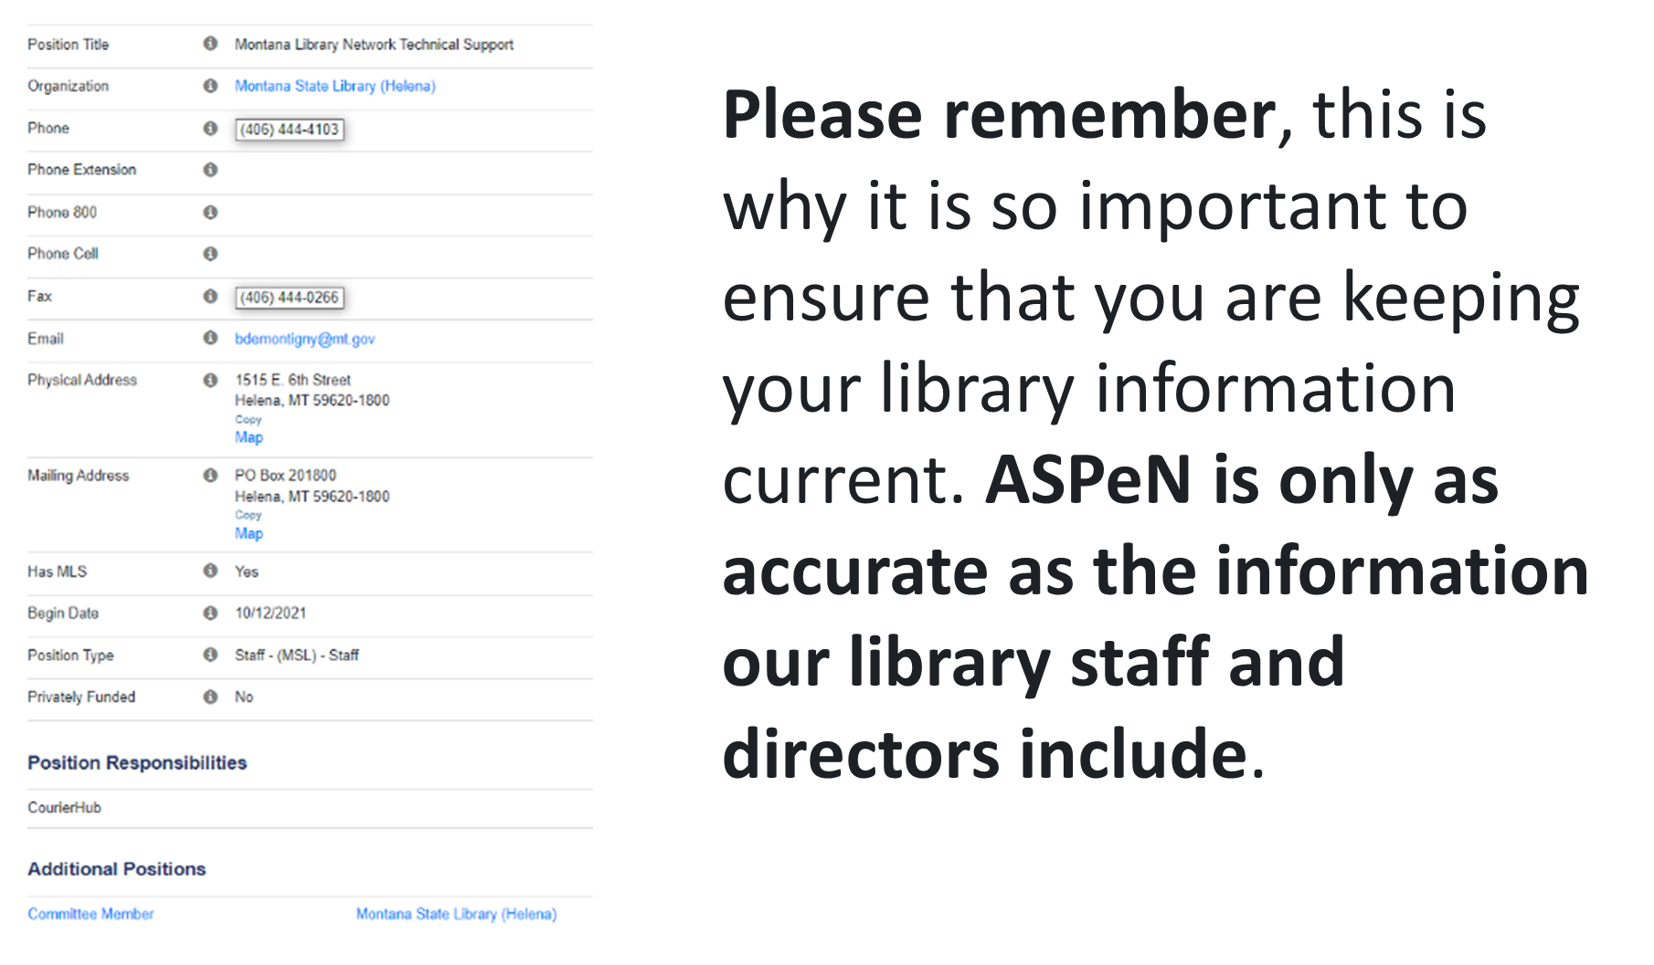

Slide 22
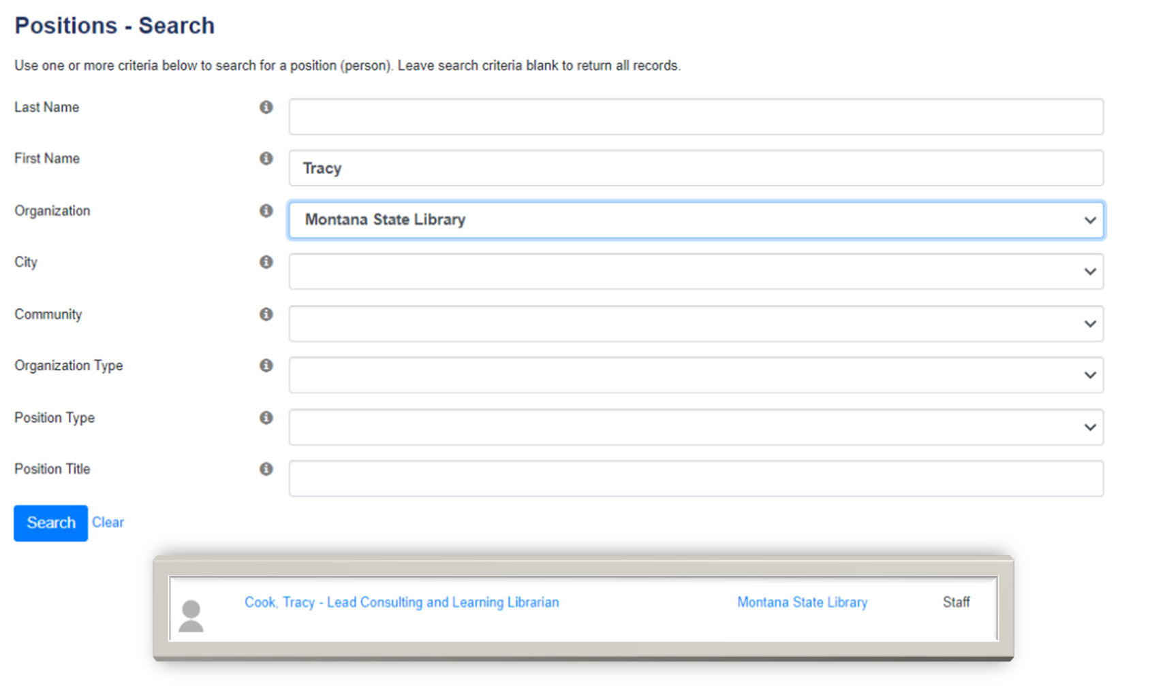

Slide 23
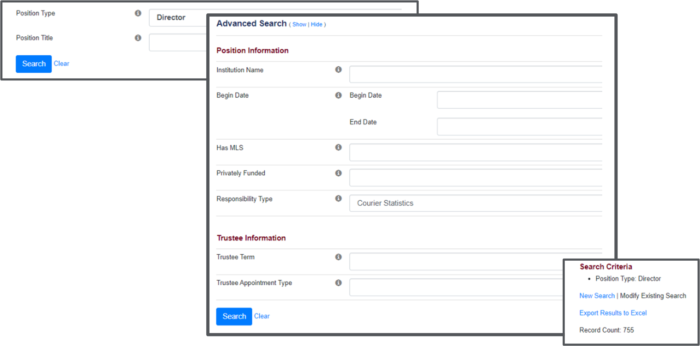

Slide 24


Slide 25
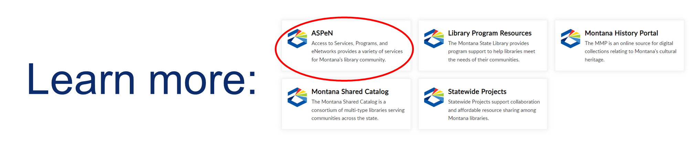

Slide 26
Technology CE
Bobbi DeMontigny
This is the tentative schedule for future Tiny Tech Training:
February 28, 2023 - ASPeN- Logging in / Searching
March 28, 2023 - Overdrive Help / Kindles and eReaders
April 25, 2023 - How do I know my ASPeN account is working? / ASPeN and Employee Turnover
May 30, 2023 - Reporting with Overdrive Marketplace / Recommending a Title in MontanaLibrary2Go
June 27, 2023 - MontanaLibrary2Go Invoices / Overdrive Marketing Materials
July 25, 2023 - Updating Organization Information in ASPeN / Selecting a CE Track in ASPeN
August 29, 2023 - Federation information / MSL Services to Libraries on the Web
September 26, 2023 - Getting Started with the Montana History Portal / Searching in the Portal
October 31, 2023 - Montana History Portal: Citing Sources / Adding Personal Collections
November 28, 2023 - Montana History Portal: Ordering Reproductions / Tagging and Recollections
December 26, 2023 - Where to find Courier Reporting in ASPeN / What is a Hotspot?
Montana Library Network Technical Support
Notes:
Next months Tiny Tech Training will specifically be about logging into ASPeN and Searching in there. If these are things you want to know more about I really hope you will attend! For this class I made a recording of a fake new account going through the steps of the login process so you can see what it is supposed to look like. Once complete this is the recording that will be available in MSL Learn as well.
I know there have been some mentions about the difficulty in finding enough sessions to cover your Technology credit requirement, so I am trying to provide you with a whole lot of CE opportunities in Tech.I be offering a Tiny Tech Training at 10:00 AM on the last Tuesday of the month, *All Year long!* These trainings focus on the types of things you need to know to use the services provided by the MSL. If you or your staff need to learn how to get around in some of these areas or even if you just need to brush up on something these trainings will help!

Slide 27
Questions?

Slide 28

Information and News Sources
MSL Website
MSL Newsletters
MSL Help Desk
ASPeN Events Calendar
MSL YouTube Channel
Email/call any MSL staff member
Notes:
https://msl.mt.gov/
https://msl.mt.gov/about/news
https://desk.zoho.com/portal/montanastatelibrary/en/home
https://mtlib.org/Wired-MT
https://mslservices.mt.gov/ASPeN/Events/
https://youtube.com/@montanastatelibrary
https://directory.mt.gov/govt/state-dir/agency/library
MSL Website Newsletters /GovDelivery Montana Library Network (MLN) Newsletter
Released 1st and 3rd Tuesdays of each month
Links to other newsletters and updates (MMP, MSC, Continuing Education)
MSL Help Desk
Submit a ticket for an issue/question/problem
Check out Knowledge Base Articles
WIRED List Serv
Time sensitive emails and news
ASPeN Events Calendar
Email/call any MSL staff member

Slide 29
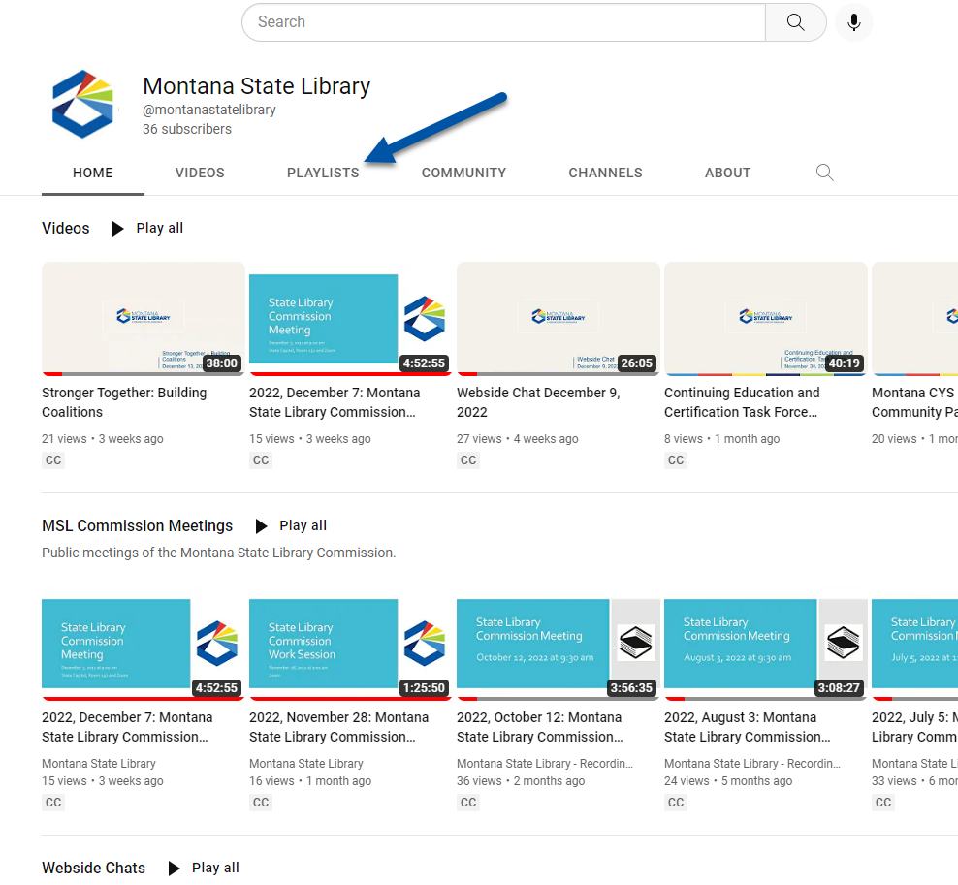
MSL YouTube Channel
Look for the MSL Learn Webinar Series Playlist
Access new recordings
Subscribe!
Notes:
Visit the MSL YouTube Channel to watch recordings if you can’t join us live!
https://youtube.com/@montanastatelibrary
You will find an MSL Learn Webinar Series Playlist.

Slide 30
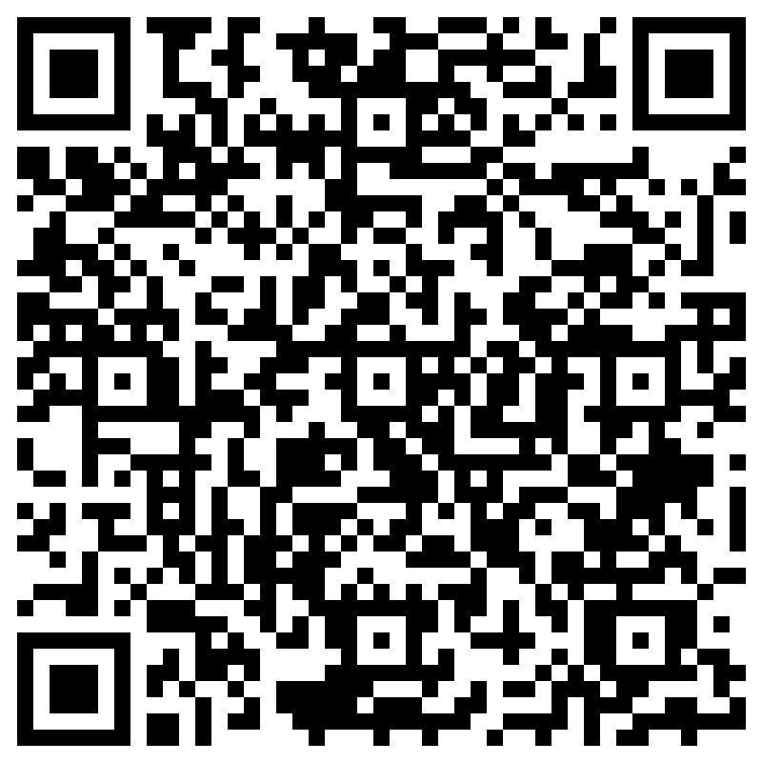
MSL Evaluation Survey
Notes:
https://forms.office.com/g/ZQ5uw9Deg6

Slide 31
Colet Bartow colet.bartow@mt.gov Bobbi DeMontigny bdemontigny@mt.gov

