Slide 1
Report Migration to BLUEcloud Analytics

Slide 2
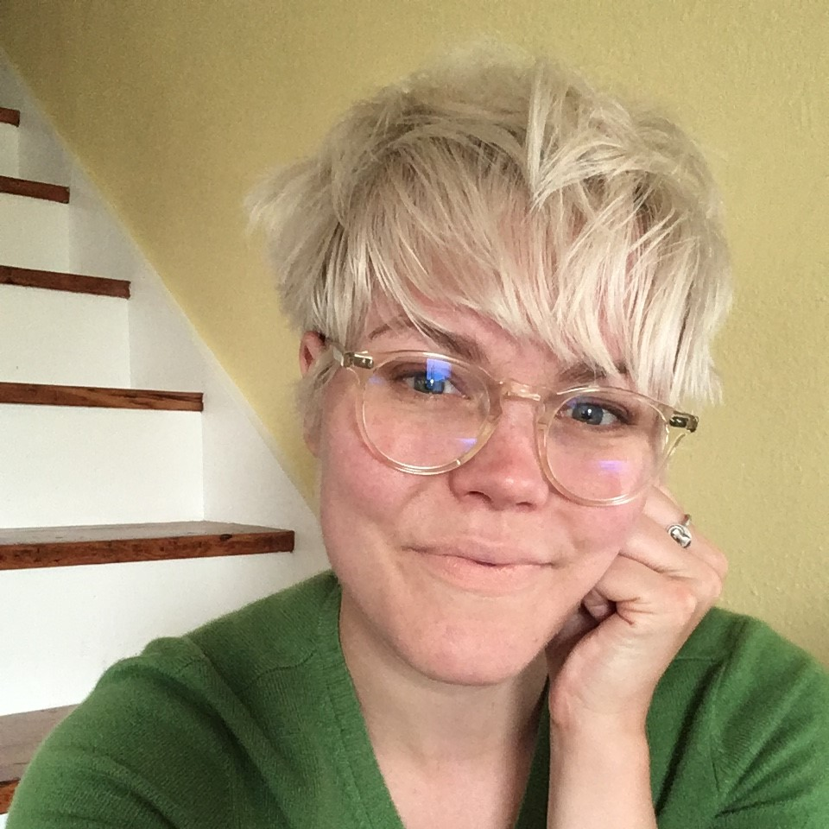
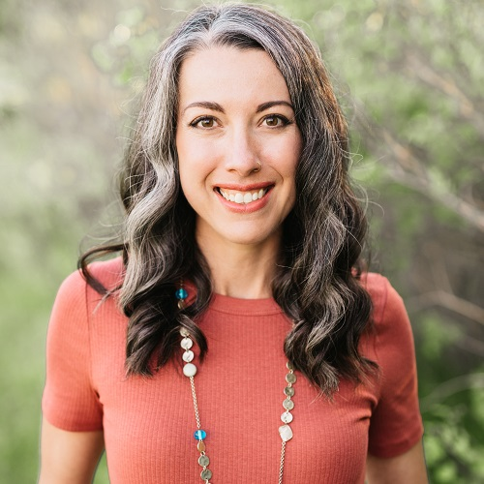
HELLO!
Keiley McGregor
MSC Trainer
Rebekah Kamp
MSC System Administrator

Slide 3
LEARNING OBJECTIVES
Identify where reports will live after the migration.
Perform basic customizations to reports in BCA.
Subscribe to customized reports to receive them via email.
Recall where to find more information on reports recommended by the MSC staff.

Slide 4
Where do I go for reports after the migration?
1

Slide 5
REPORT HOMES AFTER MIGRATION
BLUEcloud Analytics (BCA)
Statistical reports, e.g., circ transactions, counts of items/users, etc.
Lists, e.g., weeding, inventory, missing, lost, etc.
Bill reports, e.g. daily cash.
Some hold reports: purchase alerts, ratios, statistics.
WorkFlows
Notices, e.g., overdue, assumed lost, etc.; some notice-like with PII (ticket).
System work reports that do heavy lifting in the background, e.g., process long overdue (PLO), acquisitions, spine labels
Some transit lists.

Slide 6
Right Now
Reports are already in BCA! If you can't find what you need, open a ticket.
December 30th
January 31st
Can't create new reports in WF.
Still have Scheduled reports (Finished tab), in-use templates (Schedule > Template)
December 15th
Have set up your email subscriptions in BCA to make your life easier (recommended).
WF scheduled reports suspended; templates archived.
(Exceptions on previous slide.)

Slide 7
How can I customize reports in BCA?
2
Examples taken from BCA – Customizing Reports

Slide 8
USEFUL DEFINITIONS
Attribute:
A characteristic or quality of an item/user/hold/transaction; an item can have attributes like:
Item cat1 (format - BOOK)
Home location (STACKS)
Barcode
Metric:
A quantifiable measure of data, such as:
Sum of circ transactions
Collection counts

Slide 9
How can I save my customized reports in BCA?
3
Examples adapted from BCA – Subscribing to a Report Using Email BCA Saving Reports (Personal View)

Slide 10
What are some “core reports” I should start with?
4
Examples taken from BCA – Core Report List

Slide 11
Questions?

Slide 12
THANKS!
Any other questions?
You can find us at our online help desk:
https://desk.zoho.com/portal/montanastatelibrary/en/home

