Slide 1

The Strategic Track to MSL certification
Montana State Library
Spring 2021

Slide 2

Today
Library administrators will explore how the library’s strategic plan is a useful framework for planning professional development for library staff
Participants will view professional development as a critical part of achieving the library’s goals and providing world-class library services to their community
Participants will identify whether or not the Strategic Track to MSL certification is a good choice for them (and their library).
mohamed_hassan on Pixabay CC0
Notes:
The Strategic Track is a new pathway to Montana State Library Certification. It was designed to provide a way for practicing professional library staff to develop a personal professional development plan, aligned to their library’s goals, so that librarians ready to focus their training on specific topics would be able to do that and still earn a certificate. This certificate has been approved as equivalent to the library administrator certificate. Today, we will explore the guidelines for this track so that practicing Montana librarians can decide if they might want to choose this option for their next MSL certificate renewal.

Slide 3
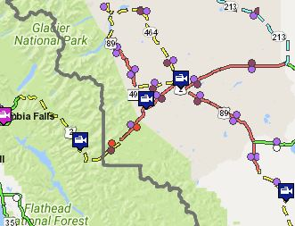
A professional Development Plan is a road map…
PDPs identify gaps between staff skills & abilities & the organization’s needs
Individual staff set out goals & desired outcomes for their training activities and identify how each of their personal goals link to the library’s goals
Plans are developed collaboratively
Both staff & organization commit to the plan
MT511 map – public domain
Notes:
A professional development plan (PDP) is a kind of map for learning. Staff are headed toward the organization’s goals and they are starting with their current level of skill and knowledge. The gap between staff capacity and library goals is the basis for the plan. You can create a PDP as part of an annual performance review. You need to have the library’s strategic plan or long range plan in hand and then staff work with their supervisor to figure out what goals in the library’s plan are the ones they should focus upon. Staff should have a lot of say in the process, but the plan should be developed together with the library’s management. Collaboration is an essential element of a productive PDP.
I have an example I would like to share – In Missoula, the library’s plan called for making the library a nexus for genealogy research in the region. So, a member of the staff is focusing most of her professional development on becoming a credentialed genealogist – the library’s resident expert.
What plans are afoot in your library? Take a minute to think about something you are undertaking at your library that could be helped by someone taking some training and expanding their expertise.

Slide 4

Your LIBRARY’s STRATEGIC PLAN – to – PDP
Write goal(s) from SP
List gaps in skills or knowledge
Research options for learning
List potential training options
Wokandapix-Pixabay CC0
Notes:
Some libraries have a one page list of annual goals, some have more involved long range plans that identify outcomes, impacts and indicators and timeline for implementation. State standards REQUIRE libraries to have a plan, but the standards do not specify how the plan looks or how it is written. Standards do state that the plan must be reviewed or updated at least once very 3 years by the library board. Most libraries collect some data and public input before the plan is approved by the board. But, some create a simple one-page list of annual goals that the director and staff develop and present to the board. Your plan does not have to be something grandiose. In fact, there are some that advocate for not spending too much time planning because our world is changing so fast. Your plan simply needs to state some goals for where you want to be in year or two or three or five. AND> if you want help, your MSL Consultant will help you write that. Every library needs a plan and you must have a plan – approved by the board – before you can develop a PDP – the Library’s plan is the framework.
Then – The PDP is just 4 quick steps: Write one or more goals based on the Strategic Plan for the learner; list gaps in skills or knowledge that the learner plans to address, identify some potential learning activities or opportunities that may address those gaps, and list specific learning activities that staff plan to attend.

Slide 5
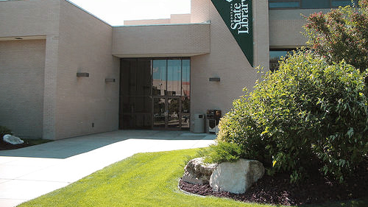
Strategic Track to Certification
Pilot 2018 -19 5 libraries
Option for self-directed, unconventional learning experiences
MSL Commission approved new track August 2019
Launched April 2021
MSL – public domain
Notes:
Your state library recognizes that our current pathway to certification – that requires at least 10 credits in each of 4 categories – does not, necessarily, support or reflect what might be in a library staff”s PDP. So, we are introducing the Strategic Track to certification that permits library staff to use their PDP as the framework for their certification rather than the 4 categories framework. This allows staff to explore a focus on one topic, like the genealogy expert in Missoula, or to seek unconventional learning activities like shadowing or conducting research for credit.
We have some limitations on who can and who cannot participate in the Strategic Track…

Slide 6
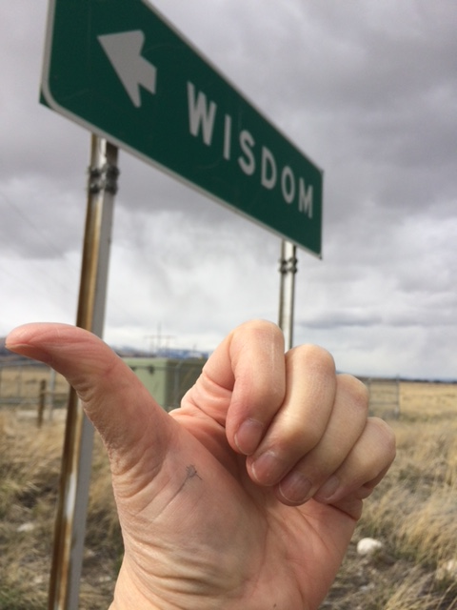
Strategic Track
Must have already earned an MSL certificate
Tethered directly to library goals
The PDP must be submitted in Moodle BEFORE credits are earned & applied
A final report/reflection
4 years to complete
Equivalent of 60+ hours of study
By Jo Flick CC0
Notes:
Here are the conditions for earning an MSL certificate with the new strategic track:
To be eligible to select the Strategic Track, a participant must have earned an MSL certificate through one of the legacy pathways: with a recent library science masters degree, or the staff or administrator tracks.
Your library must have a current strategic plan that meets the library standards; that means your plan has to have been reviewed and updated and approved by the library board within the last 3 years. For special libraries that are governed by their organization, the organization’s strategic plan may be sufficient. The important concept is that the participant is developing their professional development plan based on the goals of their organization.
If you want to participate in this track, you must develop your professional development plan and complete the planning form in ASPeN before you begin to collect credits. The concept here is that process of planning, in collaboration with your supervisor and with consideration of the library’s goals is a very important and valuable step in advancing skills and knowledge. It’s a shift from the staff choosing and attending training sessions based on their interests to really engaging in talent development and filling skill gaps in the library.
When you submit your application for certification, you’ll be asked to write a brief final report/reflection about your learning experience. These built-in planning and reflection points are intended to help our participants be engaged in their professional development, but also to inform MSL and library administrators of how things are going in the development of our talents in the library world.
The Strategic Track is similar to the legacy tracks in that you must complete the work within 4 years

Slide 7
Self-Directed Learning
3 hours of time = 1 credit
Not a requirement of the strategic track
Maximum -20 credits total
MUST BE PLANNED
By Jo Flick CC0
Notes:
A new feature of this Strategic Track is that is allows participants to plan and earn credit for learning activities beyond the traditional classroom or webinar training. In the MSL Strategic Track, these are referred to as “Self-directed” learning activities. Self-directed learning activities are awarded credit similar to an independent study in college – about 3 hours of your time will equal one credit. This could be independent research like reading or gathering and analyzing data, or a non-traditional learning activity like shadowing a mentor or taking time to play with new software or hardware.
We found in our pilot that this option was something special, that a librarian likely won’t do every time they renew, and that MSL consulting staff or the CE Coordinator, may need to be involved in the planning and implementation of individuals that opt for this option.
In order to earn credit for a self-directed learning activity it must be planned in advance. The learner needs to attain the permission of their supervisor in advance and submit their plan in ASPeN. Then, they are expected to track their hours in a journal or on a form. Finally, they must submit a final report on the learning activity that documents what they learned, provides evidence of that learning, and reflects on any follow-up or further training they need.
An example might be if staff is assigned to develop and maintain a new online resource for the library. They might view a series of tutorials or shadow an expert to learn how to utilize the technology, use some referent books to guide their work, and conduct some usability tests along the way learn how what adjustments are needed. Between the research and practice, they spend 90 hours actively LEARNING, but that time is not in a classroom or at a presentation or webinar. That would be the equivalent of 30 credits, but the maximum that can be earned this way is 20, so the staff claim 20 hours toward certification. Every hour of their work should be documents in a journal or form.

Slide 8
Strategic Track
60 credits total
Within 4 years – credits expire
No category requirements
Plan may be altered/updated as needed
Consider: 2 tracks in ASPeN
MSL learning logo
Notes:
Much of what is required in the Strategic Track is the same as the Admin and Staff tracks, the big difference is that there is no category requirement – that is replaced by the professional development plan linked to the library’s goals.
If you attend a traditional training session or webinar, you claim credit for that the same way as with the other tracks.
We recommend that participants who are seeking a certificate in this track, also open another track – staff or admin at the same time. It’s possible that as you work on your professional development, you discover that you are eligible to renew in one of the other tracks and that will save you the time and effort of completing the Strategic Track final report.
A Strategic Track certificate is issued as an equivalent Administrator Track. Once you have earned a certificate, you may want to continue with a new strategic track or return to one of the legacy tracks. We expect that seasoned library staff that continue to have focused jobs and learning needs may continue with this track. Others may decide to do it once to achieve a specific goal and then return to one of the legacy tracks.

Slide 9
Launch - April 2021
Enroll in Strategic Track Moodle Course
Select the Strategic Track option in ASPeN; get link to enroll from Jo
Complete reporting in Moodle
Data is harvested by MSL staff into ASPeN and certificates are awarded in ASPeN
MSL learning logo
Notes:
The new track was launched in April. Find a recording of an introductory webinar on the MSL Vimeo
MSL staff have created a Moodle Course that will guide participants through the process and permit them to upload their initial Professional Development Plan, any optional revisions to the plan, and to submit final reports. The only activity in ASPeN required at this time is to select the Strategic Track.
MSL staff receive data and notifications from Moodle so when participants have completed the course requirements, that data will be imported into the Montana State Library database, ASPeN and certificates will be processed and awarded in ASPeN.

Slide 10

Joann Flick jflick@mt.gov or your favorite MSL Consulting Librarian
Pixabay CC0

